Slide 1
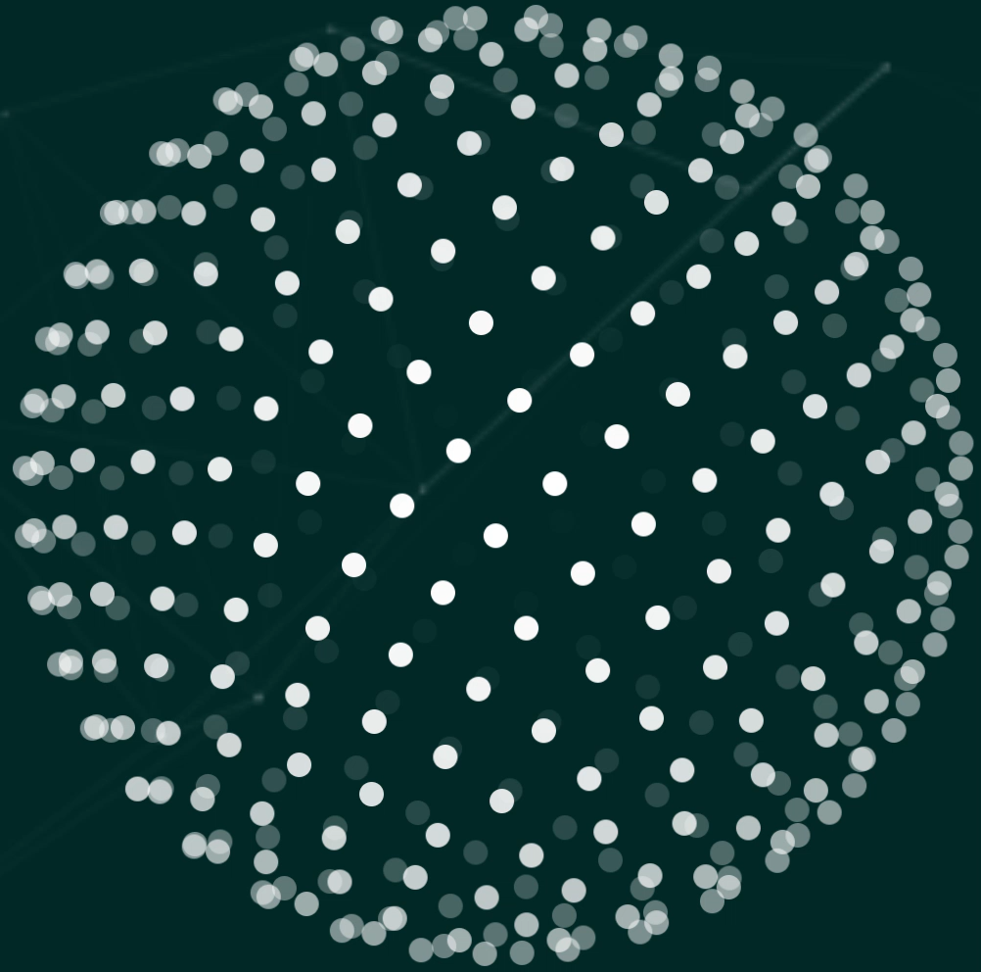










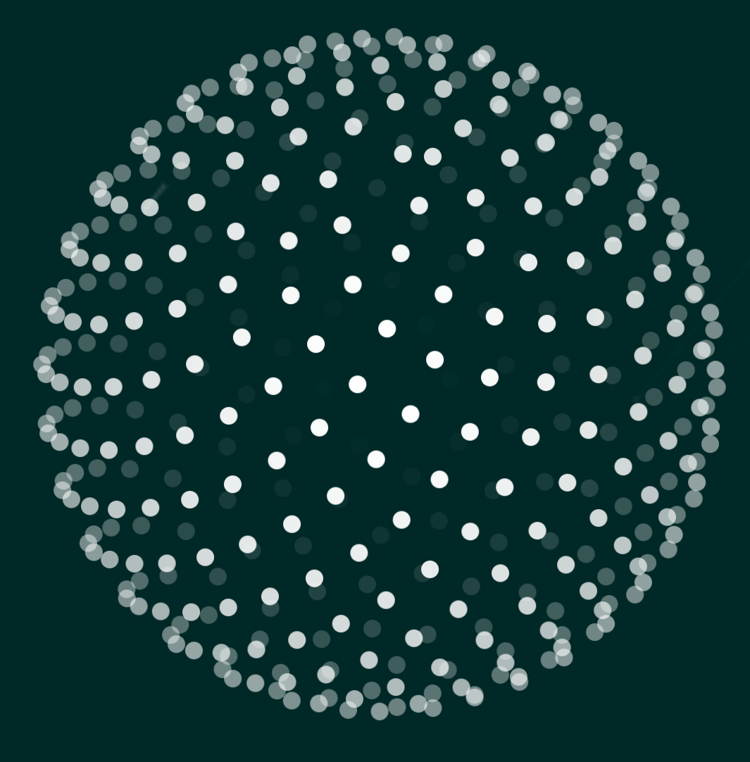


Quantum Innovation Challenge 2025
quantum-challenge.eu
A joint innovation challenge partnership between
Supported by industry experts

Slide 2
Quantum Innovation Challenge 2025
quantum-challenge.eu
Team EntagledAngle
Nandan Patel & Isshaan Singh
Vellore Institute of Technology,
Chennai, India

Slide 3

Quantum-Enhanced Pharmacometric Modeling
Team Entangled Angle
Nandan Patel, Isshaan Singh, Reena Monica
Integrating Variational Quantum Circuits into SAEM for Improved PK/PD Parameter Inference
Aim: Use quantum variational circuits to enhance parameter sampling in nonlinear mixed-effects pharmacokinetic–pharmacodynamic modeling, improving exploration of complex posterior distributions and enabling more efficient parameter estimation.

Slide 4





Mechanistic PK/PD Modeling
An ODE-Based Approach for Drug Development
Integrating mechanistic frameworks with Monte Carlo simulations for robust drug development
dy/dt = f(y,t,p)
EQTC Presentation
Team Entangled Angle
November 11, 2025
Nandan Patel, Isshaan Singh, Reena Monica

Slide 5


















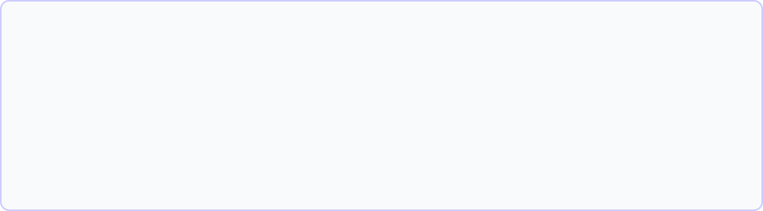






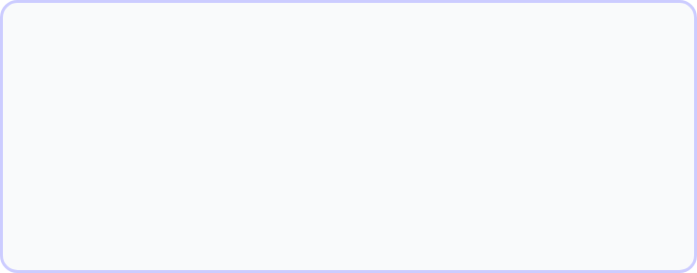






Research Objective & Dataset Overview
Research Objective
Dataset Structure
Establish link between administered drug doses and measurable outcomes
Dimensions:
2820 rows × 11 columns
Column
Description
Role in Modeling
Simulate realistic treatment scenarios and develop informed dosing recommendations
ID
Subject identifier
Tracks repeated measures
Investigate how drugs move through the body (PK) and their effects (PD)
BW
Body weight (kg)
PK covariate
COMED
Concomitant medication
PD covariate
Key Challenge:
Connecting complex physiological processes to observable measurements while accounting for individual variability
DOSE
Administered dose (mg)
Primary driver
TIME
PK Measurements
PD Outcomes
Drug concentrations in plasma
Biomarker levels
Mechanistic PK/PD Modeling: An ODE-Based Approach for Drug Development
2
2/8

Slide 6















Modeling Framework Rationale
ODE-based Framework
Machine Learning Approach
Mechanistic link between drug administration, concentration, and effect
Focuses on mapping inputs to outputs rather than modeling dynamics
Scientifically interpretable models grounded in pharmacometric research
VS
Black-box methods lack mechanistic interpretability
Difficult to reason about population-level behaviors
Computationally efficient once formulated
Not designed to reflect physiological processes like clearance or compartmental distribution
Aligns with operations research principles of simplifying complex systems
Monte Carlo Integration
Accounts for variability across patients and clinical scenarios
Explores range of possible outcomes under uncertainty
Why Our Approach?
Our principled, ODE-based framework with Monte Carlo sampling provides a robust and interpretable tool that balances complexity with simplicity. This approach allows for accurate capture of real-world variability while maintaining clear interpretation and meaningful clinical insights.
Mechanistic PK/PD Modeling: An ODE-Based Approach for Drug Development
3
3/8

Slide 7











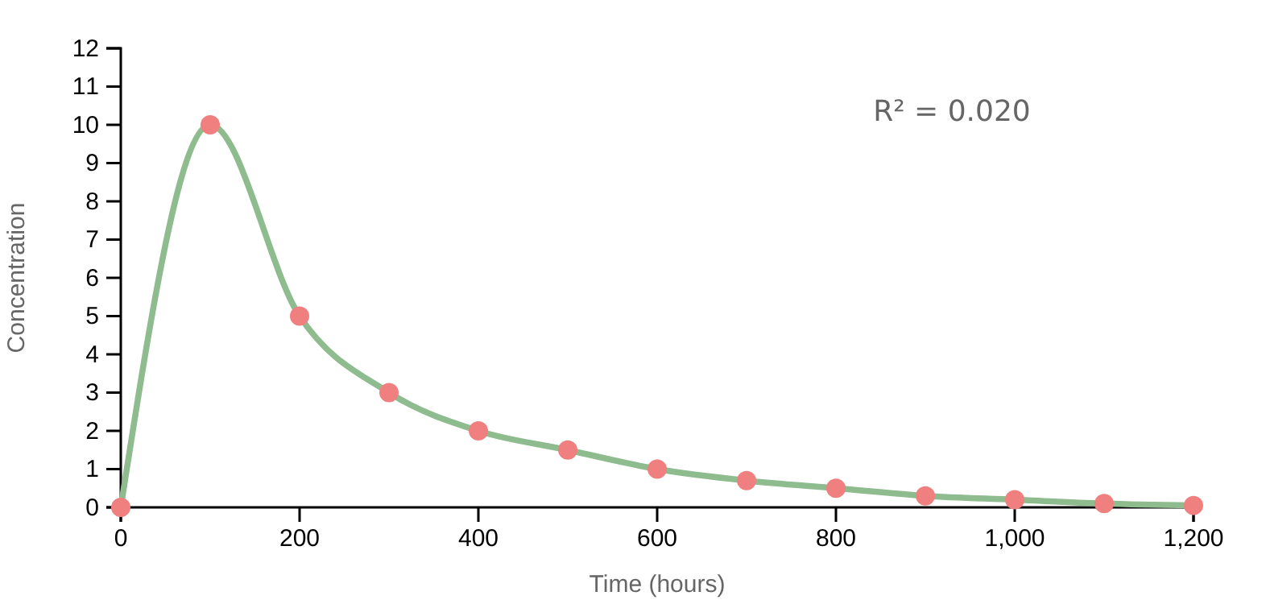


Key Exploratory Findings: PK Structure
2-Compartment Model
First-Order Absorption
Body Weight Effects
Non-parallel elimination curves (R² = 0.020)
Rapid rise within first 2 hours
Strong correlation (r = 0.680)
No lag time or plateau
Allometric scaling (BW^1.33)
Biphasic elimination profile
Biphasic Elimination Profile
Key Insights
Dose-proportional increases across 1, 3, and 10 mg doses confirm linear pharmacokinetics
Peak concentrations at 400 hours indicate slow accumulation to steady-state
37.5% CV confirms substantial inter-subject variability
52% of clearance variability explained by allometric scaling
Parallel lines = mono-exponential decay (R² = 0.020)
Non-parallel curves = 2-compartment model
Mechanistic PK/PD Modeling: An ODE-Based Approach for Drug Development
4
4/8

Slide 8








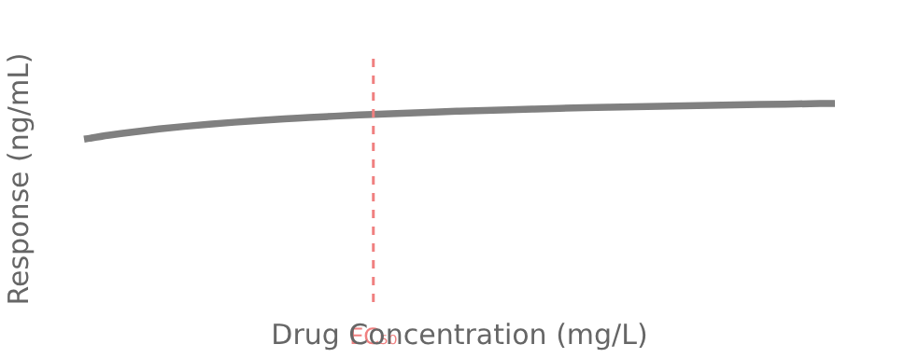

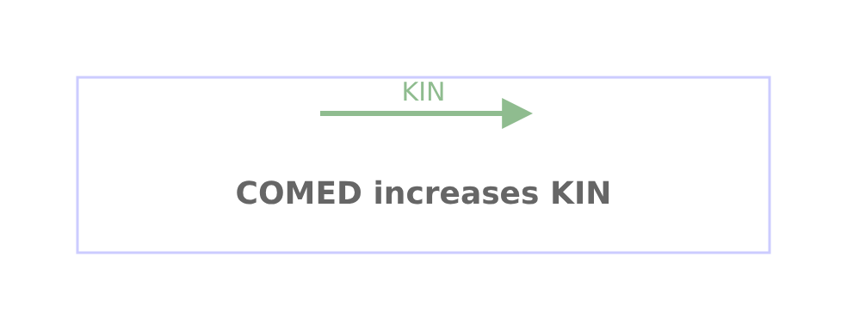
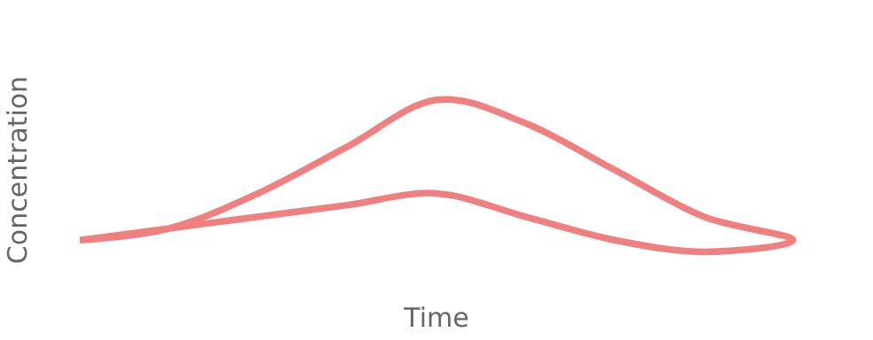


Key Exploratory Findings: PD Linkage
Indirect Response Mechanism
Emax Relationship
COMED Effects
Counterclockwise hysteresis loop confirms time delay between PK and PD
EC₅₀:
5.779 mg/L
Non-significant p = 0.2368; wider variability in suppression
E₀:
7.94 ng/mL
Eₘₐₓ:
10.36 ng/mL
COMED increases baseline biomarker production (KIN)
Moderate PK-PD correlation (-0.612) supports indirect link
Classic Emax inhibitory model supports biomarker suppression profile
Mechanistic insight: COMED likely affects KIN parameter
Need for effect compartment in model structure
Key Insight: The 100-hour temporal lag between peak PK (400h) and PD (500h) justifies inclusion of an effect compartment with equilibration rate constant (KE0) in the model.
Mechanistic PK/PD Modeling: An ODE-Based Approach for Drug Development
5
5/8

Slide 9






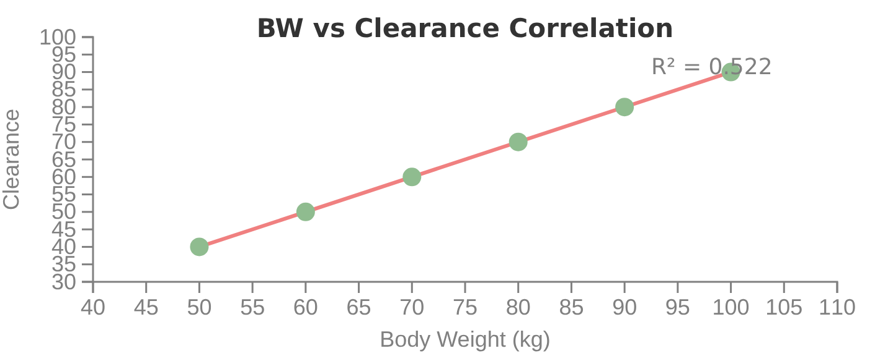
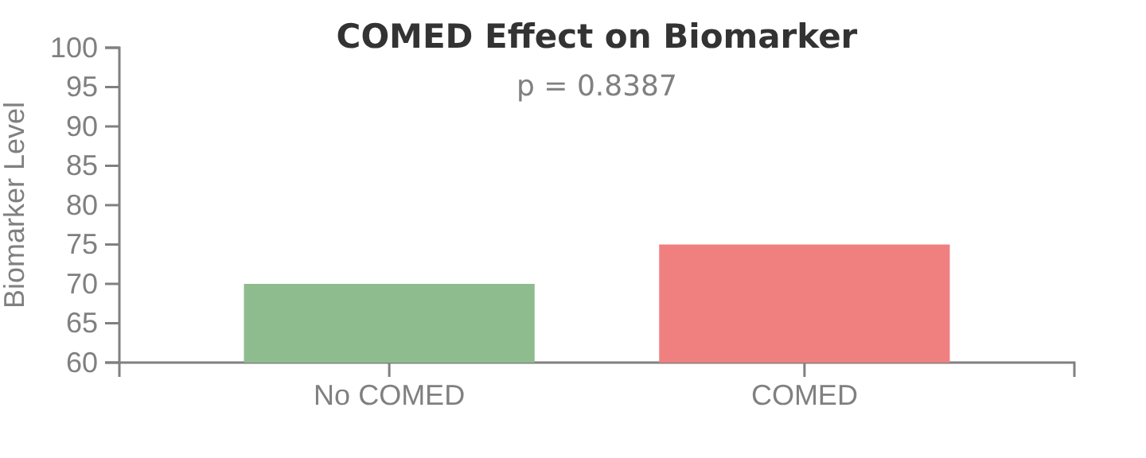



Covariate Impact Analysis
Body Weight (BW) Impact
Concomitant Medication (COMED)
Strong positive correlation with clearance (r = 0.680)
Minimal effect on PK clearance (p = 0.8387)
Allometric fit (BW, R² = 0.522) explains 52% of clearance variability
Affects PD response, likely by increasing baseline biomarker production (KIN)
Decision: Include allometric scaling for CL and V
Shows wider variability and slightly lower median suppression
Model Implementation:
CL = CLtypical × (BW/70)
Model Insight:
COMED increases baseline biomarker production (KIN), validating its inclusion as a covariate on KIN in the indirect response model
Mechanistic PK/PD Modeling: An ODE-Based Approach for Drug Development
6
6/8

Slide 10





































Final Integrated Model Structure
Model Architecture
Mathematical Structure
Four-state compartmental model
PK Component:
Effect Site:
ODE-based framework with Monte Carlo sampling
dA₁/dt = KA·Dose(t) - CLᵢ·A₁/V₁ᵢ
dAₑ/dt = KE₀·(A₁ - Aₑ)
dA₂/dt = Q·(A₁/V₁ᵢ - A₂/V₂)
R(t) = KINᵢ·(1 - IMAX·Cₑ/(IC₅₀ + Cₑ))
Log-normal IIV on all parameters
Integrated PK/PD Model Structure
Dose(t)
KA
CL
Central Compartment
KE₀
BW → CL
Effect Site
(A₁)
(Aₑ)
Q
Inhibit
Covariates
COMED → KIN
BW, COMED
Peripheral Compartment
PD Response
(A₂)
(R(t))
Variability Structure
•
•
•
•
•
•
Log-normal IIV on parameters
PK Component
PD Component
Proportional error (PK: 20%, PD: 15%)
•
•
•
2-compartment model
Indirect response model
Monte Carlo sampling
First-order absorption
Effect compartment (KE₀)
Allometric scaling (BW)
Emax relationship (EC₅₀ = 5.78)
7
7/8

Slide 11










Clinical Impact & Future Directions
Clinical Impact
Future Directions
Provides robust framework for accurate dose optimization
Explore quantum-enhanced methods to improve predictions
Balance between model complexity and interpretability
Expand model complexity to capture additional biological mechanisms
Enables simulation of treatment scenarios with meaningful clinical insights
Integrate with machine learning approaches for improved accuracy
Supports regulatory-compliant modeling with mechanistic interpretability
Apply to broader range of drug development scenarios
Key Achievement:
Quantum Approach:
Integrated framework that maintains scientific rigor while enabling clinical decision-making
Leverage quantum computing for enhanced simulation capabilities and improved generalizability
This foundational work sets the stage for future optimization efforts and advanced methodologies to improve predictions in drug development.
8
Mechanistic PK/PD Modeling: An ODE-Based Approach for Drug Development
8/8

Slide 12





Classical SAEM Framework
The stochastic approximation expectation–maximisation (SAEM) algorithm iteratively refines population PK/PD parameters through a cycle of random-effects generation, likelihood evaluation, and parameter updates.
Compute log‑likelihood
Sample η
Update θ
Cycle arrows
Classical limitation: Random effects proposals typically drawn from simple Gaussian distributions—inefficient for correlated or multimodal posteriors, leading to poor chain mixing and slow convergence.
10

Slide 13
Motivation for Quantum Enhancement
Classical Gaussian sampling struggles to capture the complex joint distributions inherent in population PK/PD models. Parameter correlations, skewed distributions, and multimodality remain poorly approximated.
Poor Mixing
Slow Convergence
Missed Correlations
Random walk behaviour leads to high autocorrelation and slow exploration.
Inefficient proposals require many iterations to reach stable estimates.
Independent Gaussian components fail to encode physiological parameter dependencies.
Solution: Variational Quantum Circuits (VQCs) learn expressive, correlated probability distributions over parameter space.
11

Slide 14
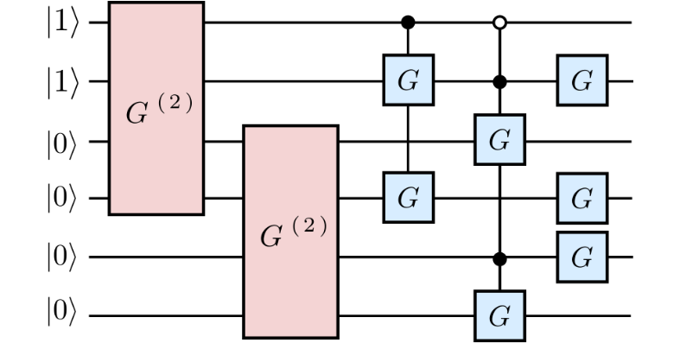
Variational Quantum Circuit Design
A 6-qubit ansatz encodes the joint distribution of key PK/PD parameters: clearance (CL), volume of distribution (V1), elimination rates, and covariate-dependent effects.
Circuit structure: Initial state |0⟩⊗⁶ → parameterised rotation layers (Rₓ, Rᵧ, Rᵤ) → CNOT entanglement blocks → measurement. Entanglement is crucial—it encodes parameter correlations reflecting true physiological dependencies.
12

Slide 15
Advantages & Expected Outcomes
Multimodal & Correlated Posteriors
Faster Convergence & Mixing
Quantum circuits learn complex joint distributions impossible to approximate with simple Gaussians.
Reduced autocorrelation and superior exploration lead to fewer SAEM iterations required.
Preserved Interpretability
Workflow Compatibility
PK/PD model structure unchanged. Quantum methods enhance sampling, not biology.
Seamlessly integrates with established pharmacometric pipelines and covariate adjustments.
13

Slide 16
Covariate Integration & Model Predictions
Covariates (body weight, concomitant medication) are incorporated classically into the structural model, whilst quantum-enhanced random effects enable richer uncertainty capture.
Covariate Effects
Prediction Framework
Body weight (BW) scales clearance and volume
Cpred(t) = f(θ, ηᵢ, BW, COMED, t)
Concomitant medication (COMED) modulates kinetic rates
Rpred(t) = g(θ, ηᵢ, BW, COMED, t)
Applied to fixed effects θ and random effects ηᵢ
Quantum sampling enhances ηᵢ estimation; structural biology remains intact.
14

Slide 17
Comparative Analysis: Quantum-Enhanced vs Classical Framework
Model Fit & Computational Performance
Metric
Quantum
Classical
Gain
Initial Log-Likelihood
−1366.81
−8403.60
6×
SAEM Convergence (min)
26
44.7
↓42%
Total Runtime (h)
4.47
2.92
+53%
Memory Usage (MB)
1131
869
+30%
Quantum circuit overhead justified by superior fit and parameter estimation efficiency.
Dose Optimisation Results
33%
25%
100%
Maximum Dose Reduction
Typical Weekly Savings
Success Rate
Heavy population, 75% target, weekly regimen
Original population, 90% target
Stable numerical convergence in all scenarios
Quantum framework enables greater personalisation via enhanced body weight and comedication sensitivity.
15

Slide 18
Results & Diagnostic Metrics
Comprehensive evaluation via pharmacological outcomes and computational diagnostics:
01
02
Log-Likelihood & Convergence
Parameter Estimates & Uncertainty
Track SAEM trajectory with burn-in marked; quantum method achieves superior plateau.
Population parameters (CL, V1, Q, V2, KA, KE0, IMAX, IC50, KIN, KOUT) with standard errors.
03
04
Inter-Individual Variability
Residual Analysis
Correlation matrices (Ω) reveal parameter relationships and covariance structure.
Log-normal (PK) and proportional (PD) error structures validate model adequacy.
05
06
Dose-Response & Covariate Effects
Computational Performance
Surface plots and bar charts quantify efficacy, body weight sensitivity, and comedication impact.
ODE evaluations, cache hits, memory usage, and runtime confirm scalability.
16

Slide 19
Plots and Charts
17

Slide 20
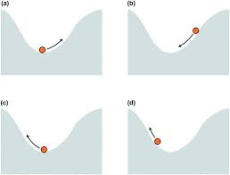
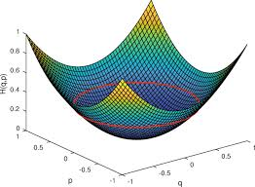
Future Work: Quantum Hamiltonian Monte Carlo
Motivation: Whilst VQC-based sampling successfully models stochastic PK/PD dynamics, Hamiltonian Monte Carlo (HMC) offers a physically intuitive and quantum-native alternative—directly sampling from the posterior via Hamiltonian evolution.
Core Principle
HMC augments parameter space θ with auxiliary momentum p and simulates Hamiltonian dynamics: H(θ, p) = U(θ) + K(p), where U(θ) = −log P(θ|data) is the potential energy and K(p) = ½pTM−1p is the kinetic energy.
Quantum Native Implementation
Quantum hardware naturally executes Hamiltonian evolution e−iHt via unitary propagation.
Expected outcome: Improved sampling efficiency and richer uncertainty quantification for population-level PK/PD inference.
18

Slide 21




Team Presentation
Isshaan Singh - MBZUAI
Nandan Patel - BQP
Dr. Reena Monica – VIT Chennai
19

Slide 22
Quantum Innovation Challenge 2025
quantum-challenge.eu
Team LoCo Quantum
Dr. Zhuo Cao & Ran Xue
Forschungszentrum Jülich,
RWTH Aachen University
Germany

Slide 23
Quantum inspired Trajectory Flow matching (QTFM)
LoCo Quantum Team
Ran Xue, Zhuo Cao, Mira Sharma and Zhongyi Jiang

Slide 24
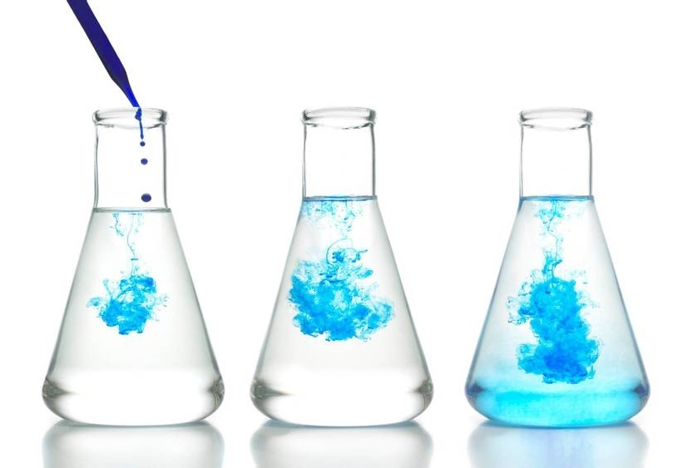
OUtline
PK/PD Problem
Trajectory Flow matching
Quantum inspired TFM
Results & Outlook
Our Team

Slide 25

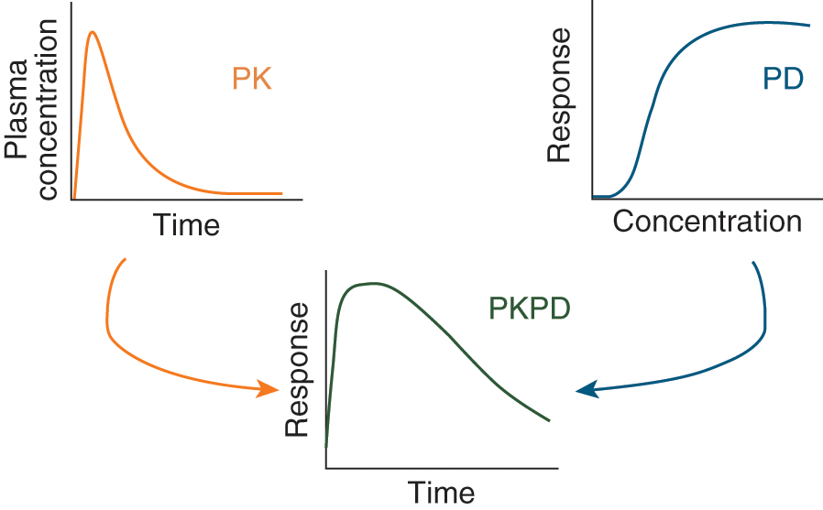
Pk/PD Problem
A dynamical system to be understood with limited clinical data.

Slide 26
Our Approach
Quantum inspired - trajectory flow matching (TFM)

Slide 27

WhY TFM?
Motivation:
Clinical data (i.e. time-series of bio-marker) = irregular, limited, noisy.
Conventional models (RNN, neural ODE/SDE) struggle with irregular sampling and simulations overhead.
Core idea:
TFM learns a continuous time-flow field from the patient trajectories (irregularly sampled data).
Training process is simlutation-free i.e. no need of back-propagation.
The learned flow field (i.e. how bio-markers evolve over time) enables continuous-time inference.

Slide 28
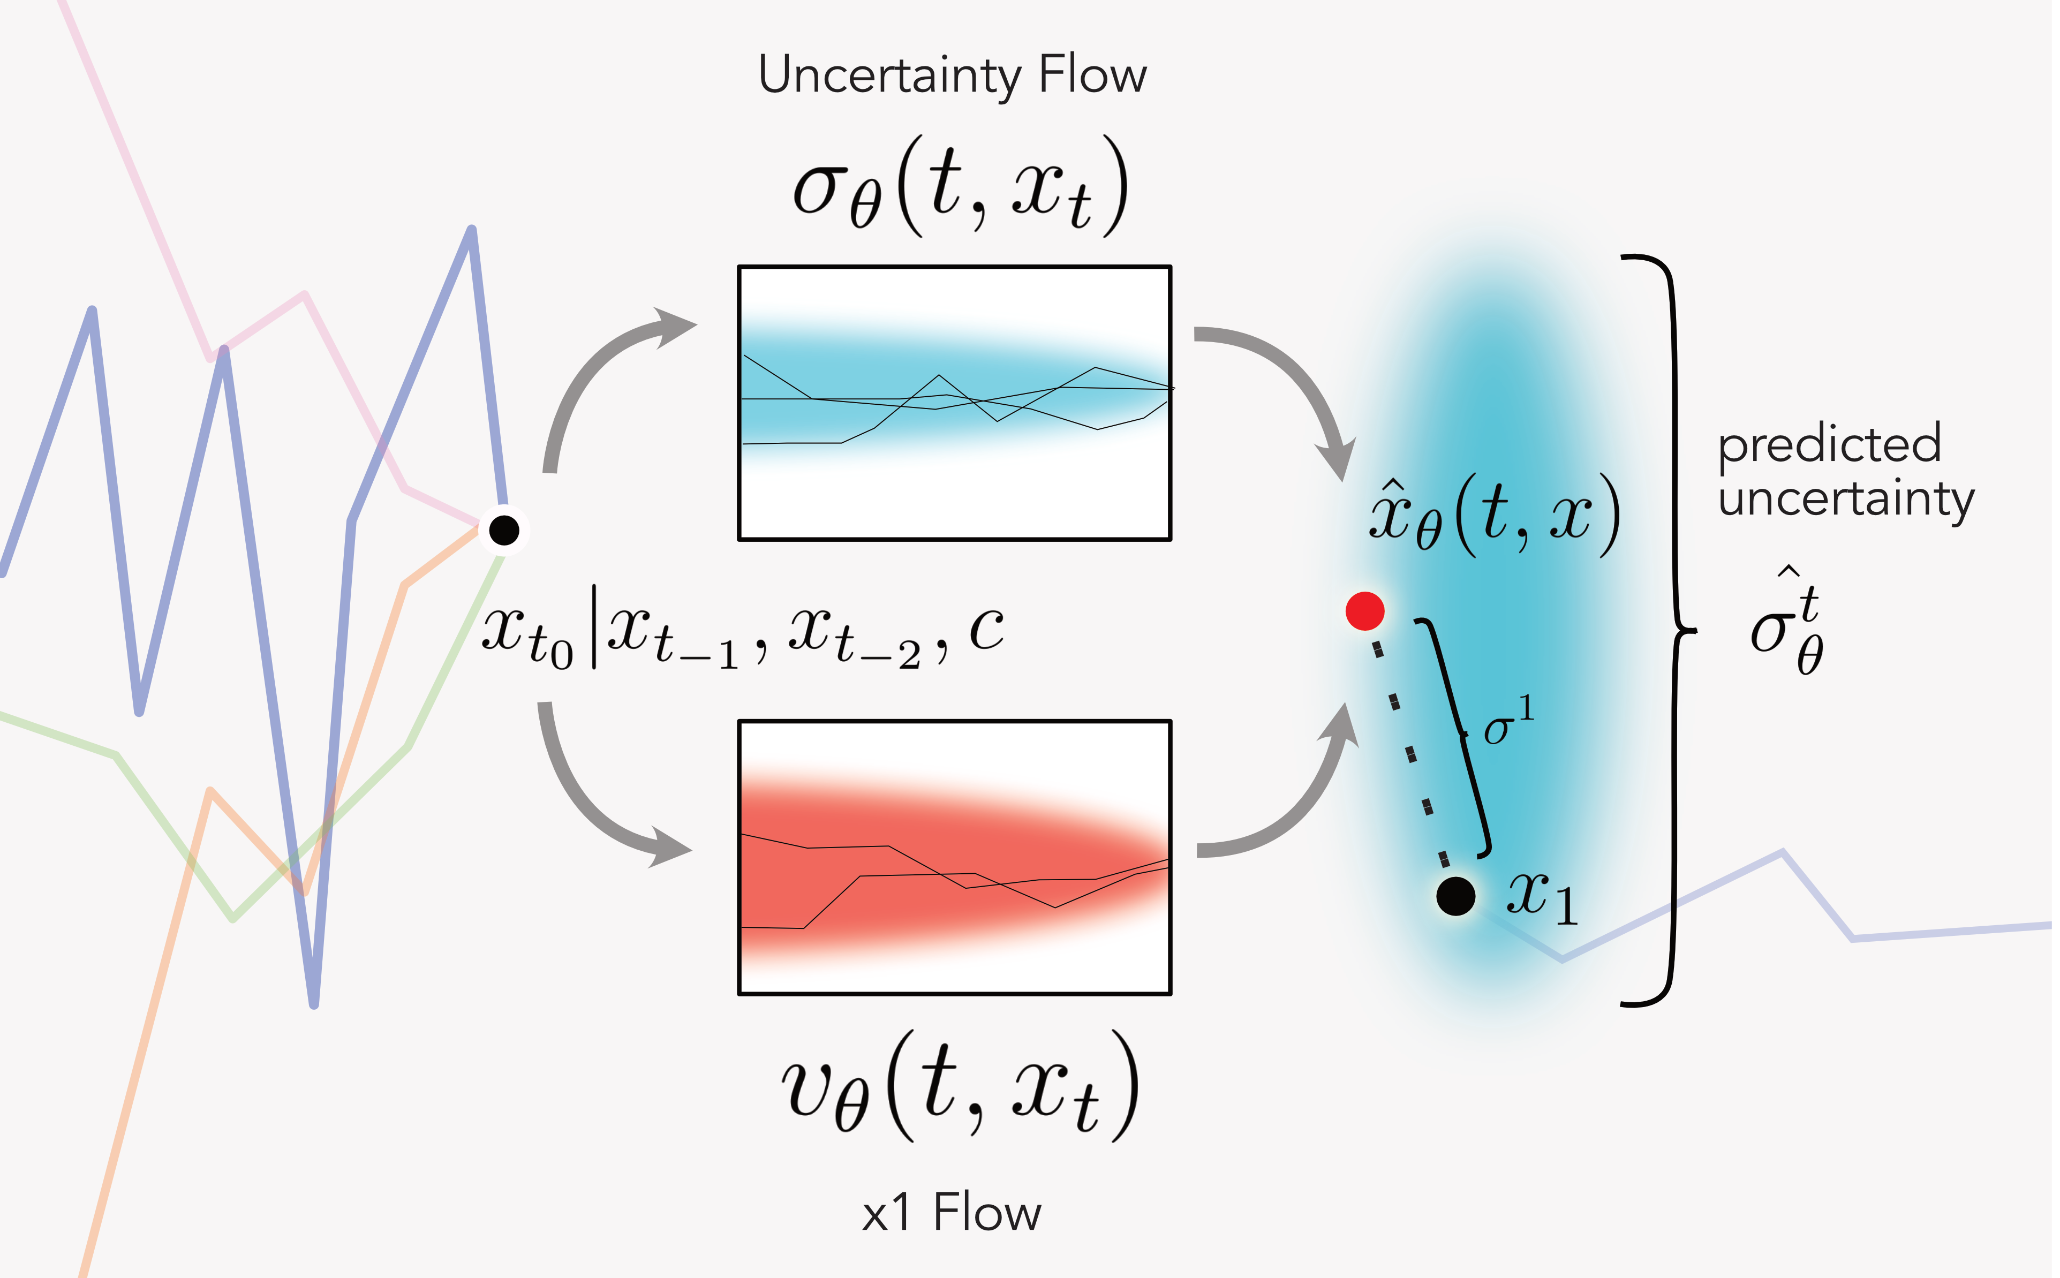
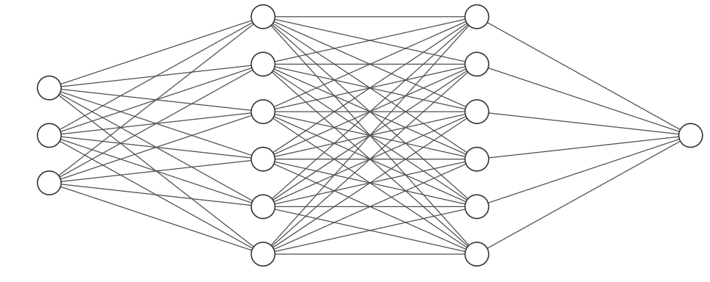
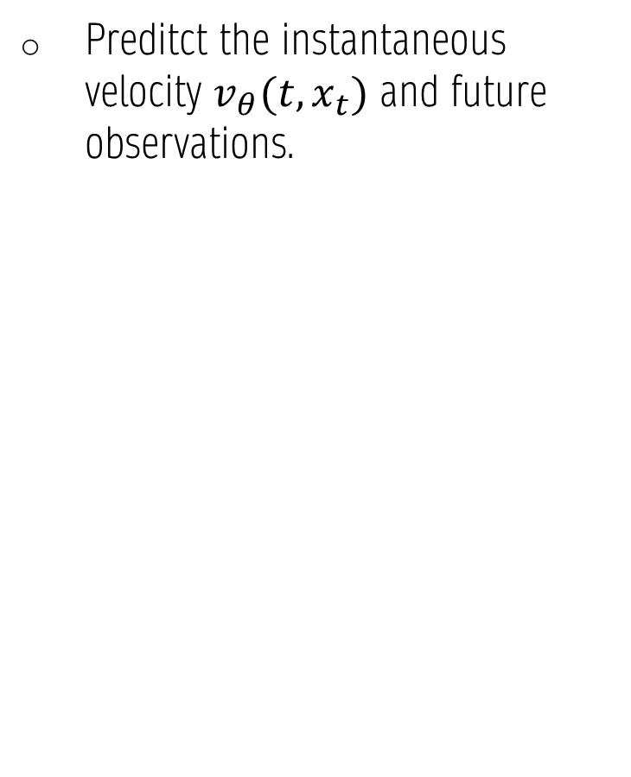
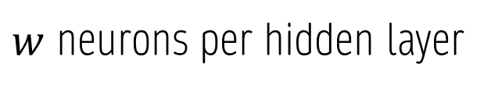
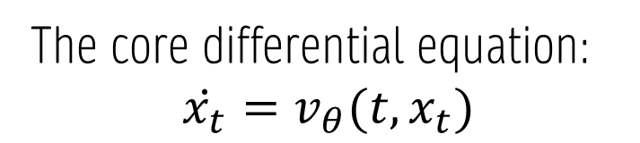
TFM Model Instance
Preditct the instantaneous velocity $v_{θ}(t, x_{t})$ and future observations.
The conventional approach:
Linear + SELU activation
IN
OUT
Hidden layers
$w$ neurons per hidden layer
The core differential equation:
$$\dot{x_{t}}=v_{θ}(t, x_{t})$$
[1] Xi Z. et al., Trajectory Flow Matching with Applications to Clinical Time Series Modeling
arXiv: 2410.21154v2 (2025)

Slide 29
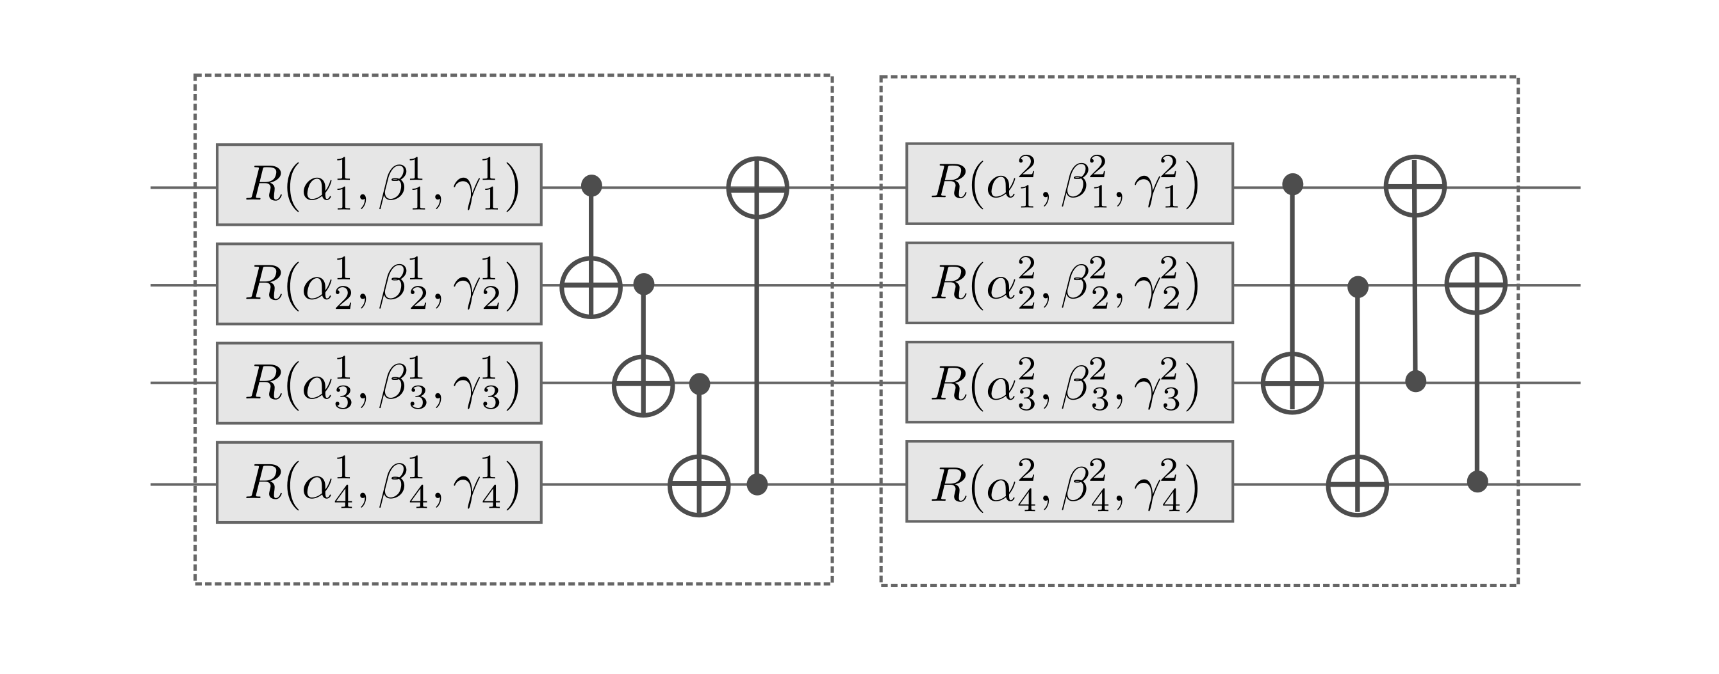
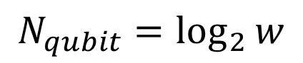
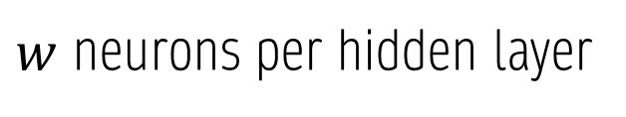
Where Quantum is applied
Quantum inspired approach:
Amplitude encoding + pairweise entanglements
MOTIVATION:
“Hidden layers” become layers of shallow variational quantum circuit.
Quantum systems encode correlations and interference naturally i.e. capturing complex and coupled nonlinearities.
Quantum dynamics are inherently continuous and unitary evolutions.
Linear + SELU activation
IN
OUT
Quantum circuits
Hidden layers
$w$ neurons per hidden layer
$$N_{qubit}=\log_{2}{w}$$

Slide 30

Advantages of using Quantum (inspired) method
Comparing to conventional methods:
Fewer trainable parameters
Faster convergence with less data
Less prone to overfitting
Uses quantum nonlinearity
→ effective activation
Uses quantum nonlocality
→ powerful feature entanglement
Comparing to Quantum Simulators
Faster inference
Lower cost
Suitable for algorithm validation and prototyping
Inspired by quantum!

Slide 31

Results

Slide 32
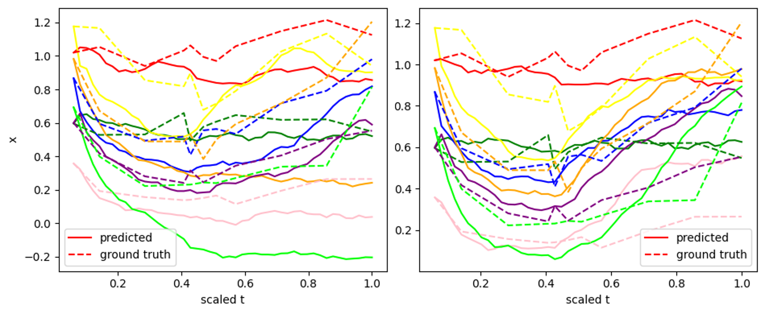
Classical vs. Quantum
Classical TFM
Quantum inspired TFM
Trainable parameters: 3,522 → 450
Validation MSE losses: 0.0708 → 0.0237

Slide 33



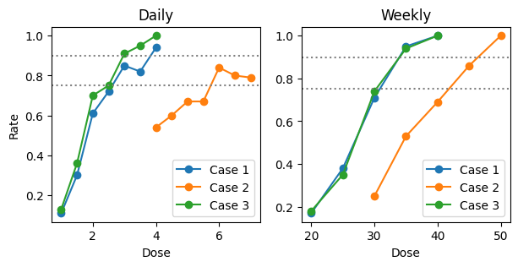



Generalizability & Scalability
Training dataset
Success rate vs dose level
Successfully suppressed bio-marker below the clinical threshold
Case 1: similar to the given data
Case 2: larger body weight
Case 3: avoid concomitant medication
Notes:
A good number of population has the biomarker suppressed below the clinical threshold.

Slide 34
Summary
Amplitude encoding + pairweise entanglements
Trajectory accuracy: MSE reduced from 0.07 to 0.02, i.e. by 70%.
Parameter efficiency: trainable parameters of QTFM has only about 10% of the classical TFM.
Linear + SELU activation
IN
OUT
Quantum circuits
Hidden layers

Slide 35
Plan for Phase 2
Completeness of existing algorithm
Extended experiments for uncertainty estimations.
Extension of Quantum inspired algorithm
Try neural ODE based training scheme.
Algorithmic benchmarking
Performance benchmarking of quantum inspired algorithms against classical baselines.
Fit PK and PD seperately, in addition to the joint modeling.
Exploration of new approach
Hardware efficiency enhancement.
Incorporate physics-informed constraintes.
Analyze computational efficiency, scalability, etc.

Slide 36

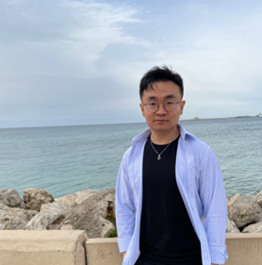


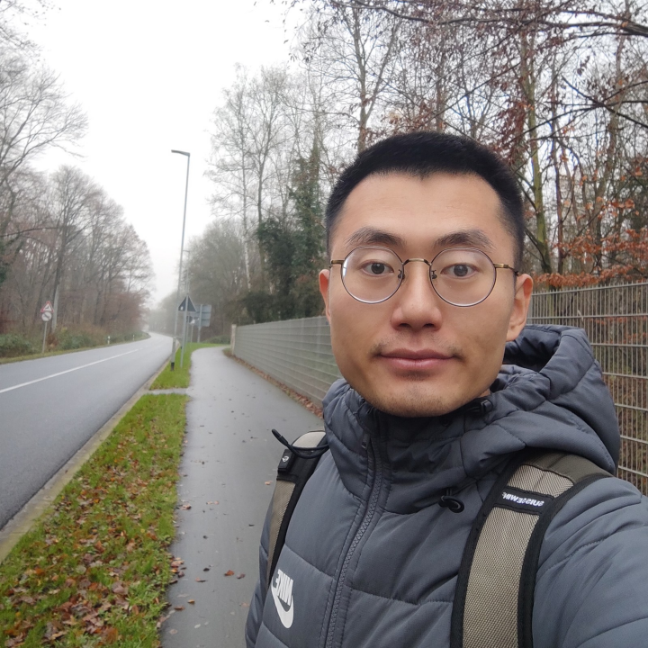
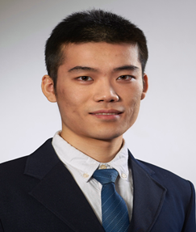
Thank You
Our Team
Dr. Zhuo Cao
Postdoc @ FZJ
Generative & explainable AI
LoCo Quantum @ LinkedIn
Dr. Mira Sharma
from RWTH Aachen
Quantum algorithm,
Spin qubits hardware & device modeling
Zhongyi Jiang
PhD student @ FZJ
Quantum algorithm, Superconducting qubits design & control
Ran Xue
PhD student @ RWTH Aachen
Quantum algorithm, spin qubits design & characterization

Slide 37
Quantum Innovation Challenge 2025
quantum-challenge.eu
Team Pharm-Jij
Lily Lee & Sofia Moliner Bobo
Jij Europe, Jij Inc. Imperial College London
United Kingdom

Slide 38
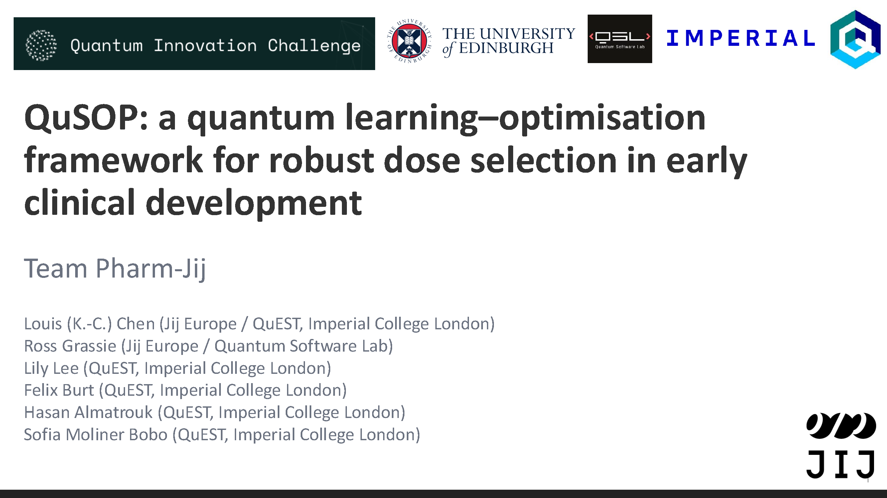

Slide 39
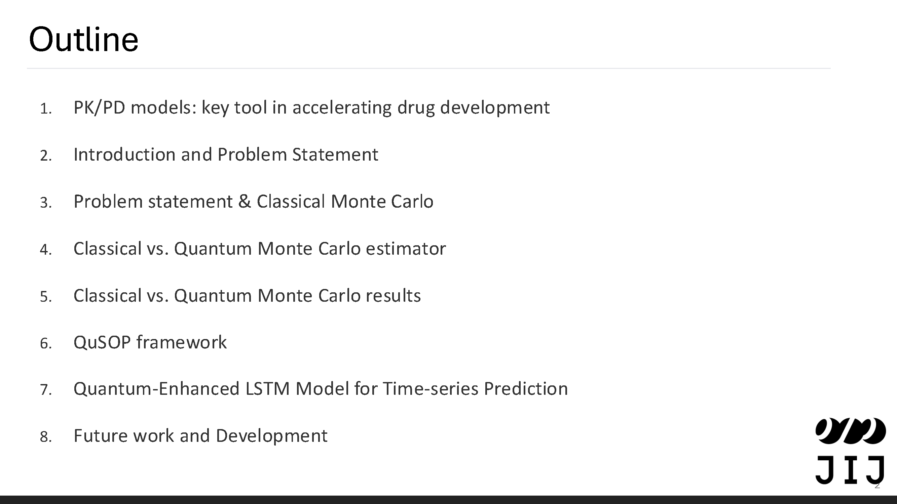

Slide 40
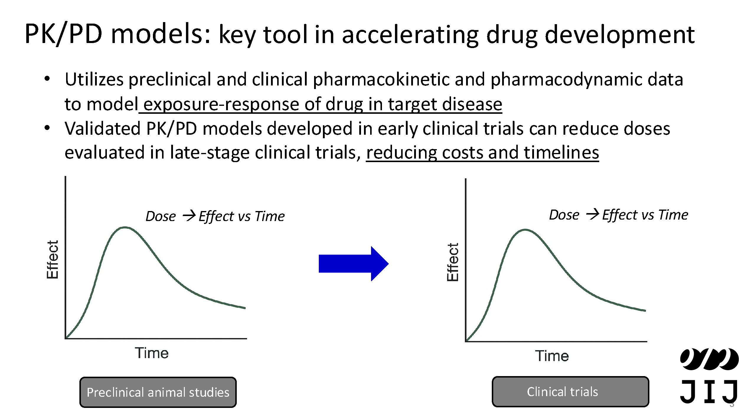

Slide 41
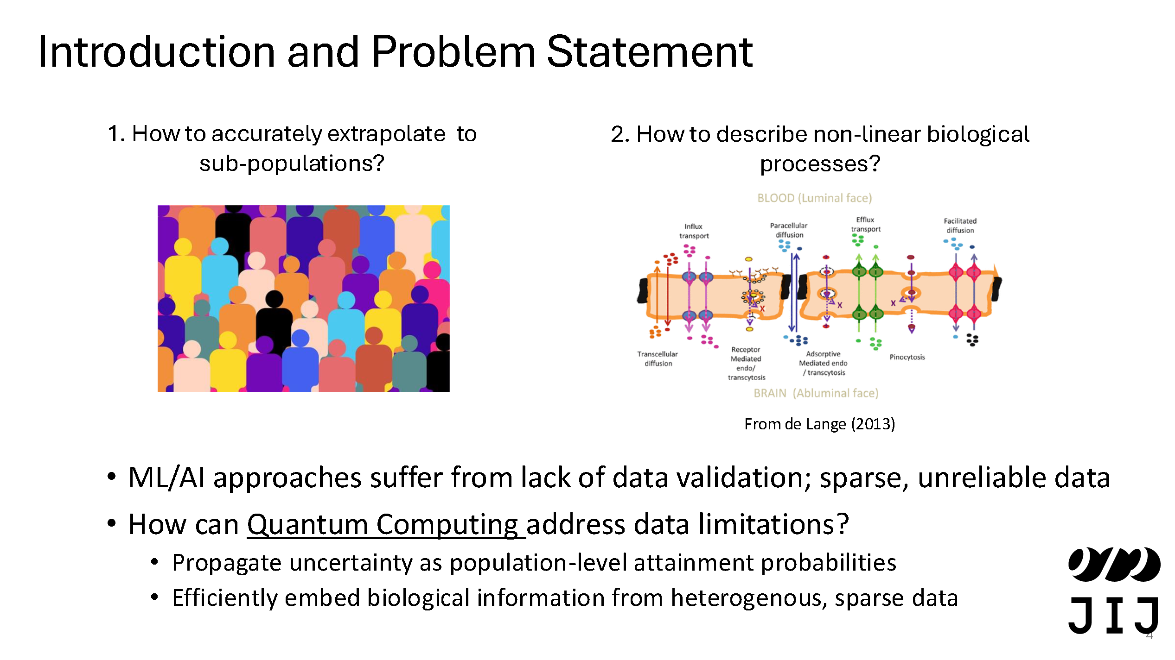

Slide 42
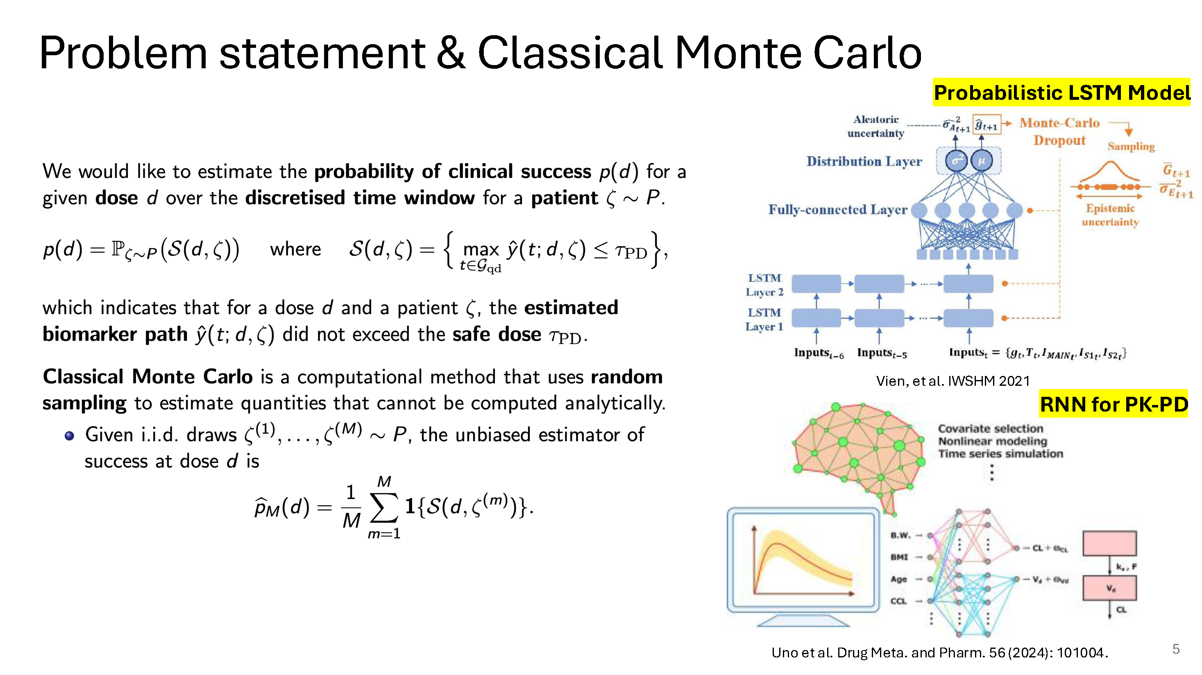

Slide 43
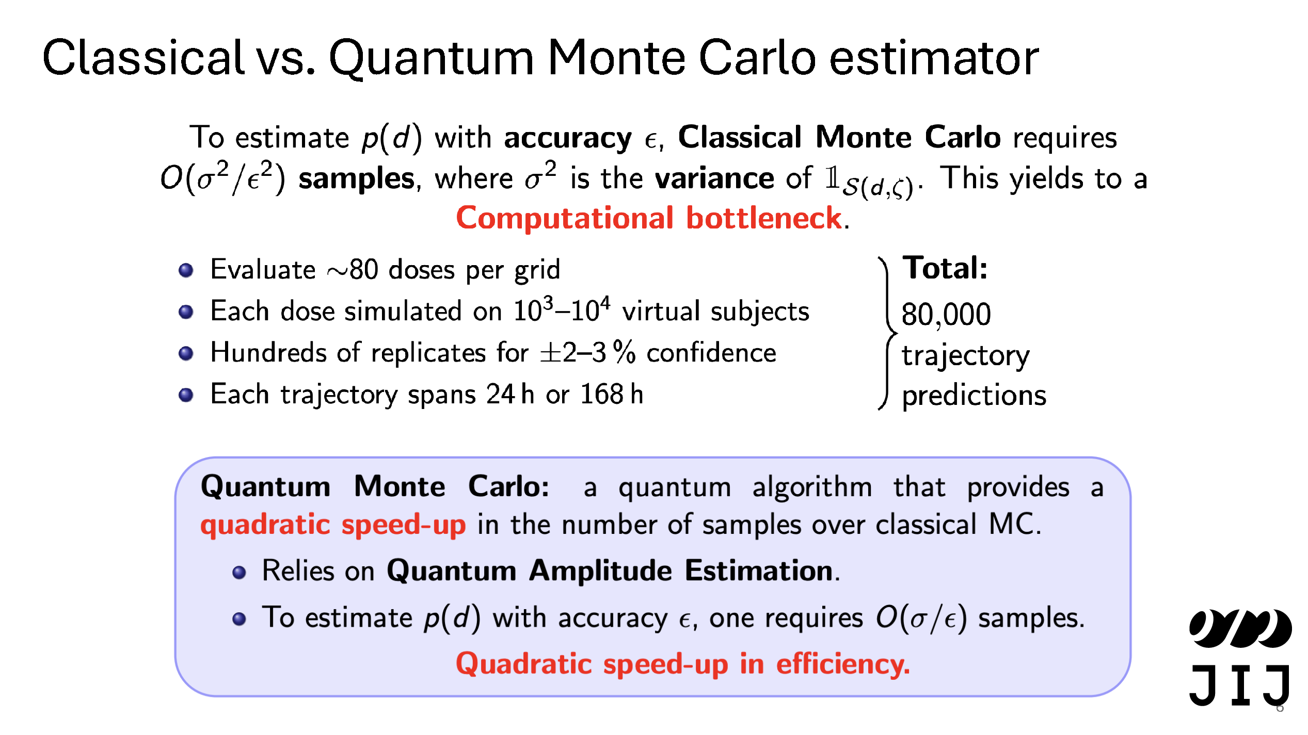

Slide 44
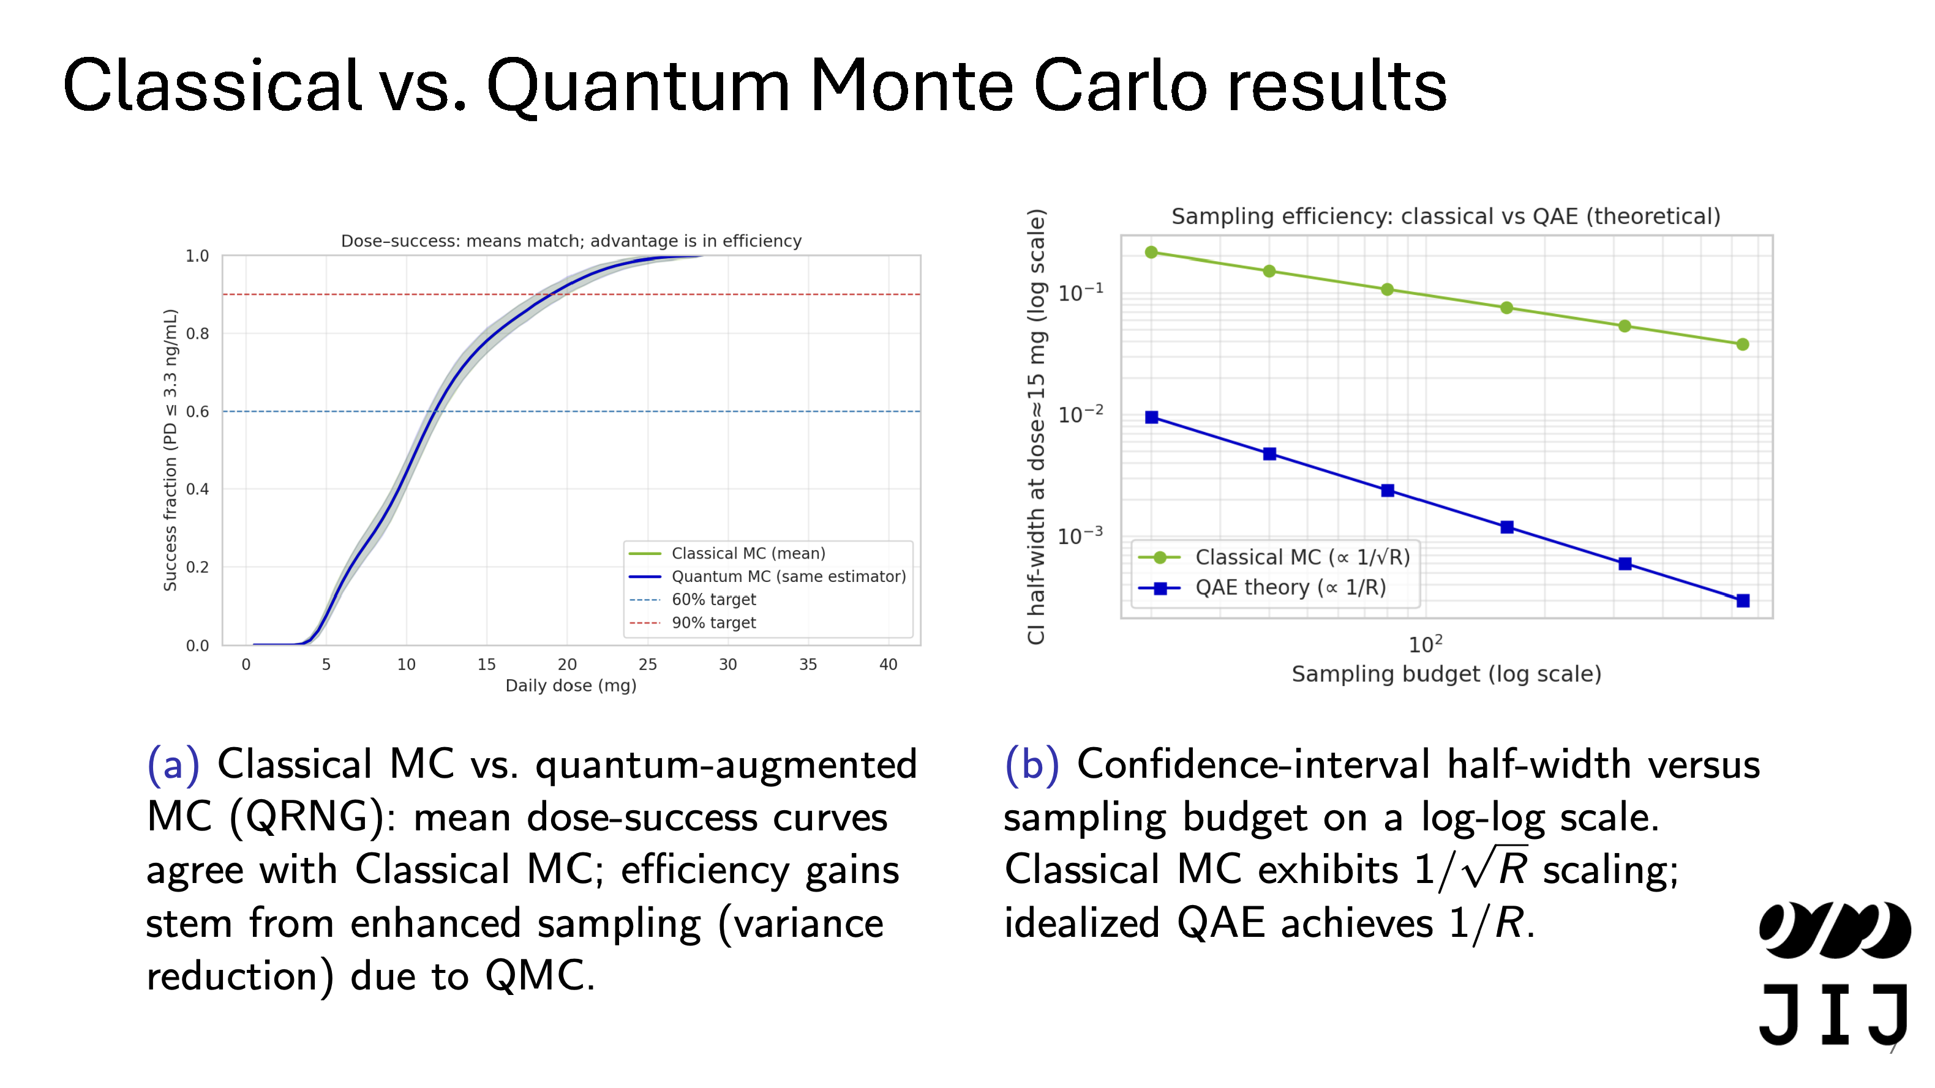

Slide 45
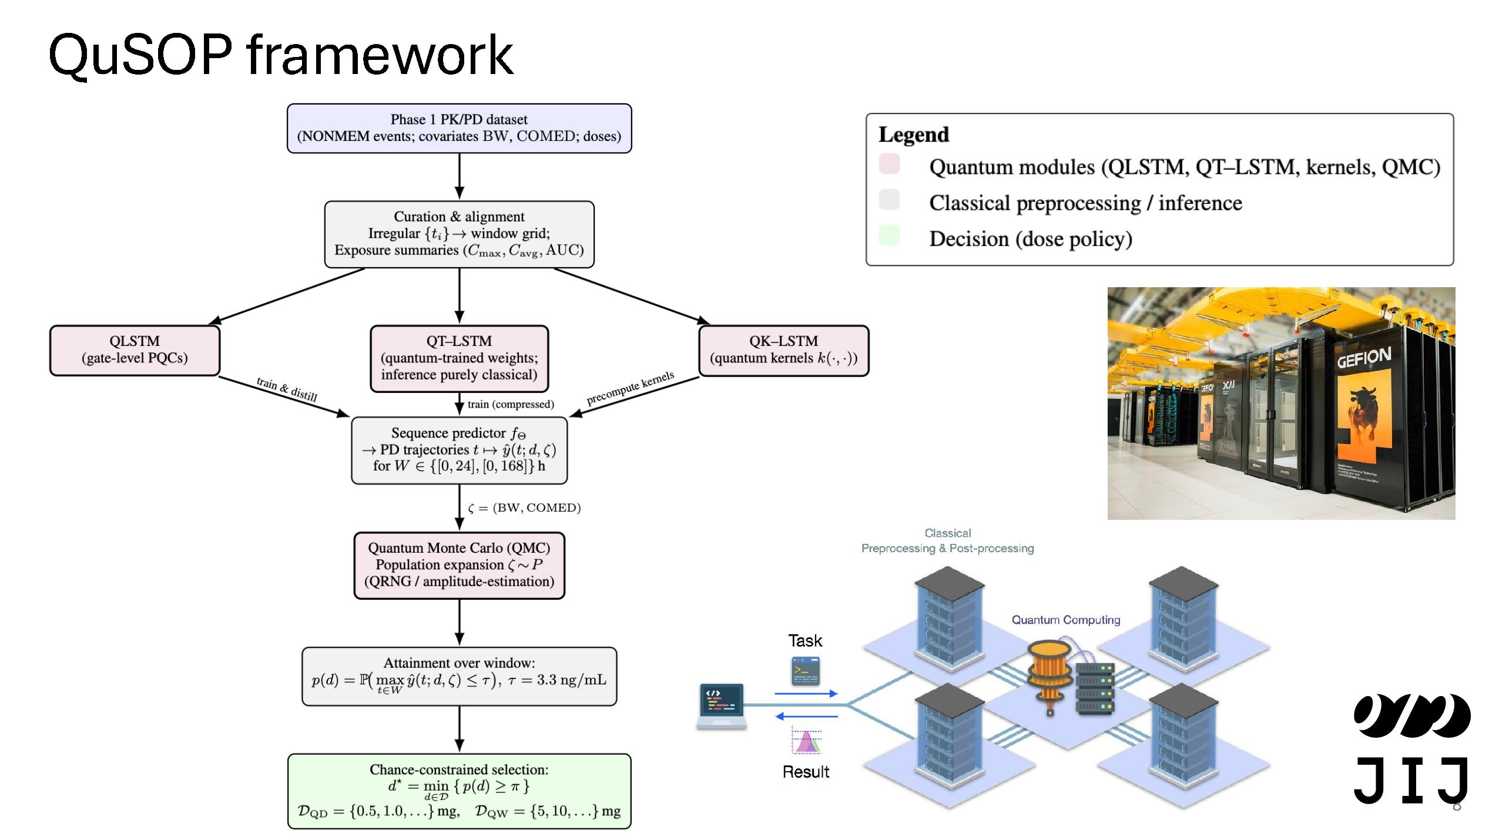

Slide 46
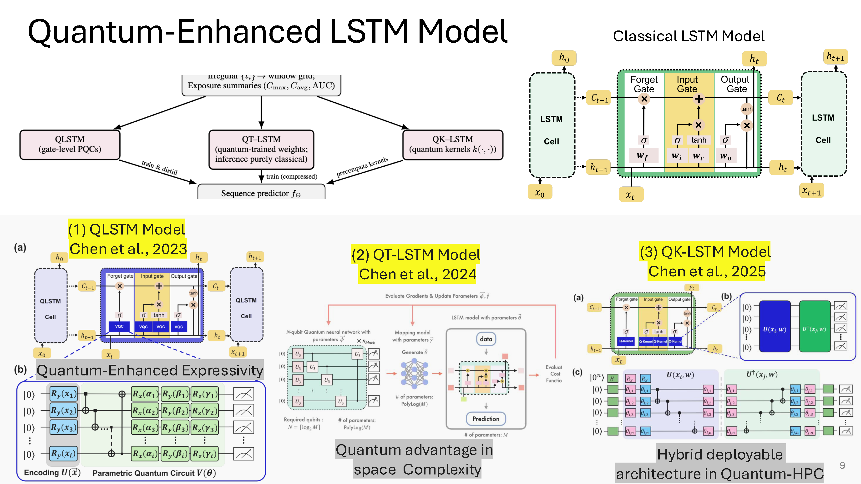

Slide 47
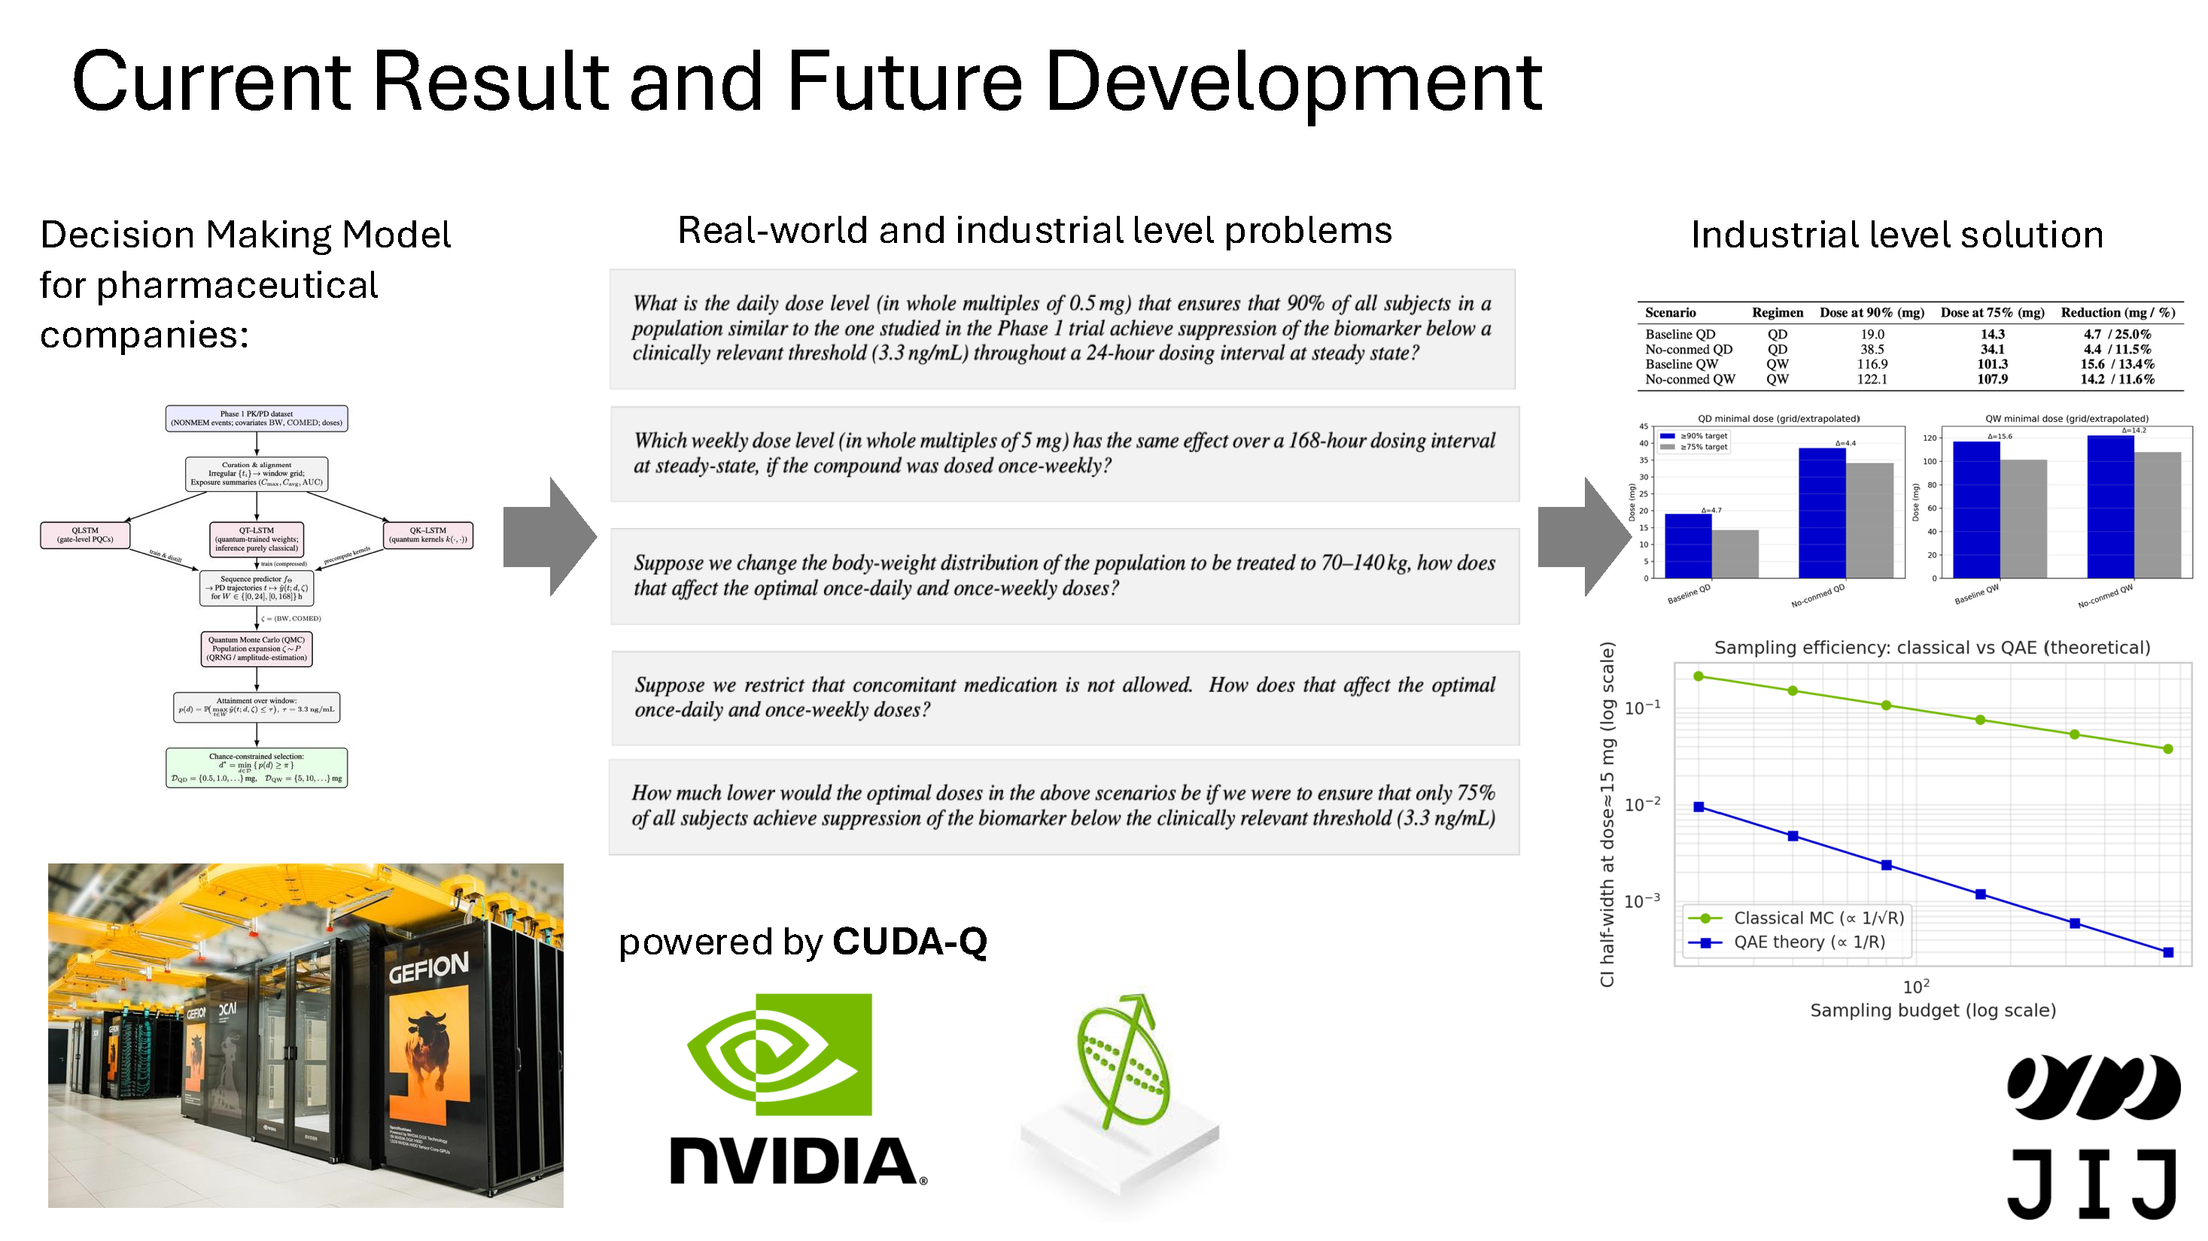

Slide 48
Quantum Innovation Challenge 2025
quantum-challenge.eu
Team PNU
Seon-Geun Jeong & Juseon Kim
Pusan National University
South Korea

Slide 49


Quantum Innovation Challenge 2025
Quantum Neural Network-enhanced Residual Multi-Layer Perceptron Mixture-of-Experts (QNN-enhanced ResMLP_MoE)
Presenter: Seon-Geun Jeong
Team PNU: Pusan National University, Republic of Korea
Seon-Geun Jeong, Ph.D Candidate
Doan Hieu Nguyen, Ph.D Candidate
Le Tung Giang, Ph.D Candidate
Mai Dinh Cong, M.S. Candidate
Sanghun Sel, Ph.D Candidate
Juseong Kim, Ph.D Candidate
Min-Gyeol Kim, M.S. Candidate
Prof. Won-Joo Hwang
Prof. Giltae Song
Prof. In-Soo Yoon
Notes:
Good afternoon. I am Seon-Geun Jeong from Team PNU. We are delighted to have been selected as one of the top five finalist teams in the Quantum Innovation Challenge 2025. Team PNU consists of Prof. Won-Joo Hwang, Prof. Gil-Tae Song, and Prof. In-Soo Yoon, together with seven master’s and doctoral students.
In this challenge, to solve the challenge tasks, we proposed Quantum neural network-enhanced residual multi layer perceptron mixture of experts.

Slide 50
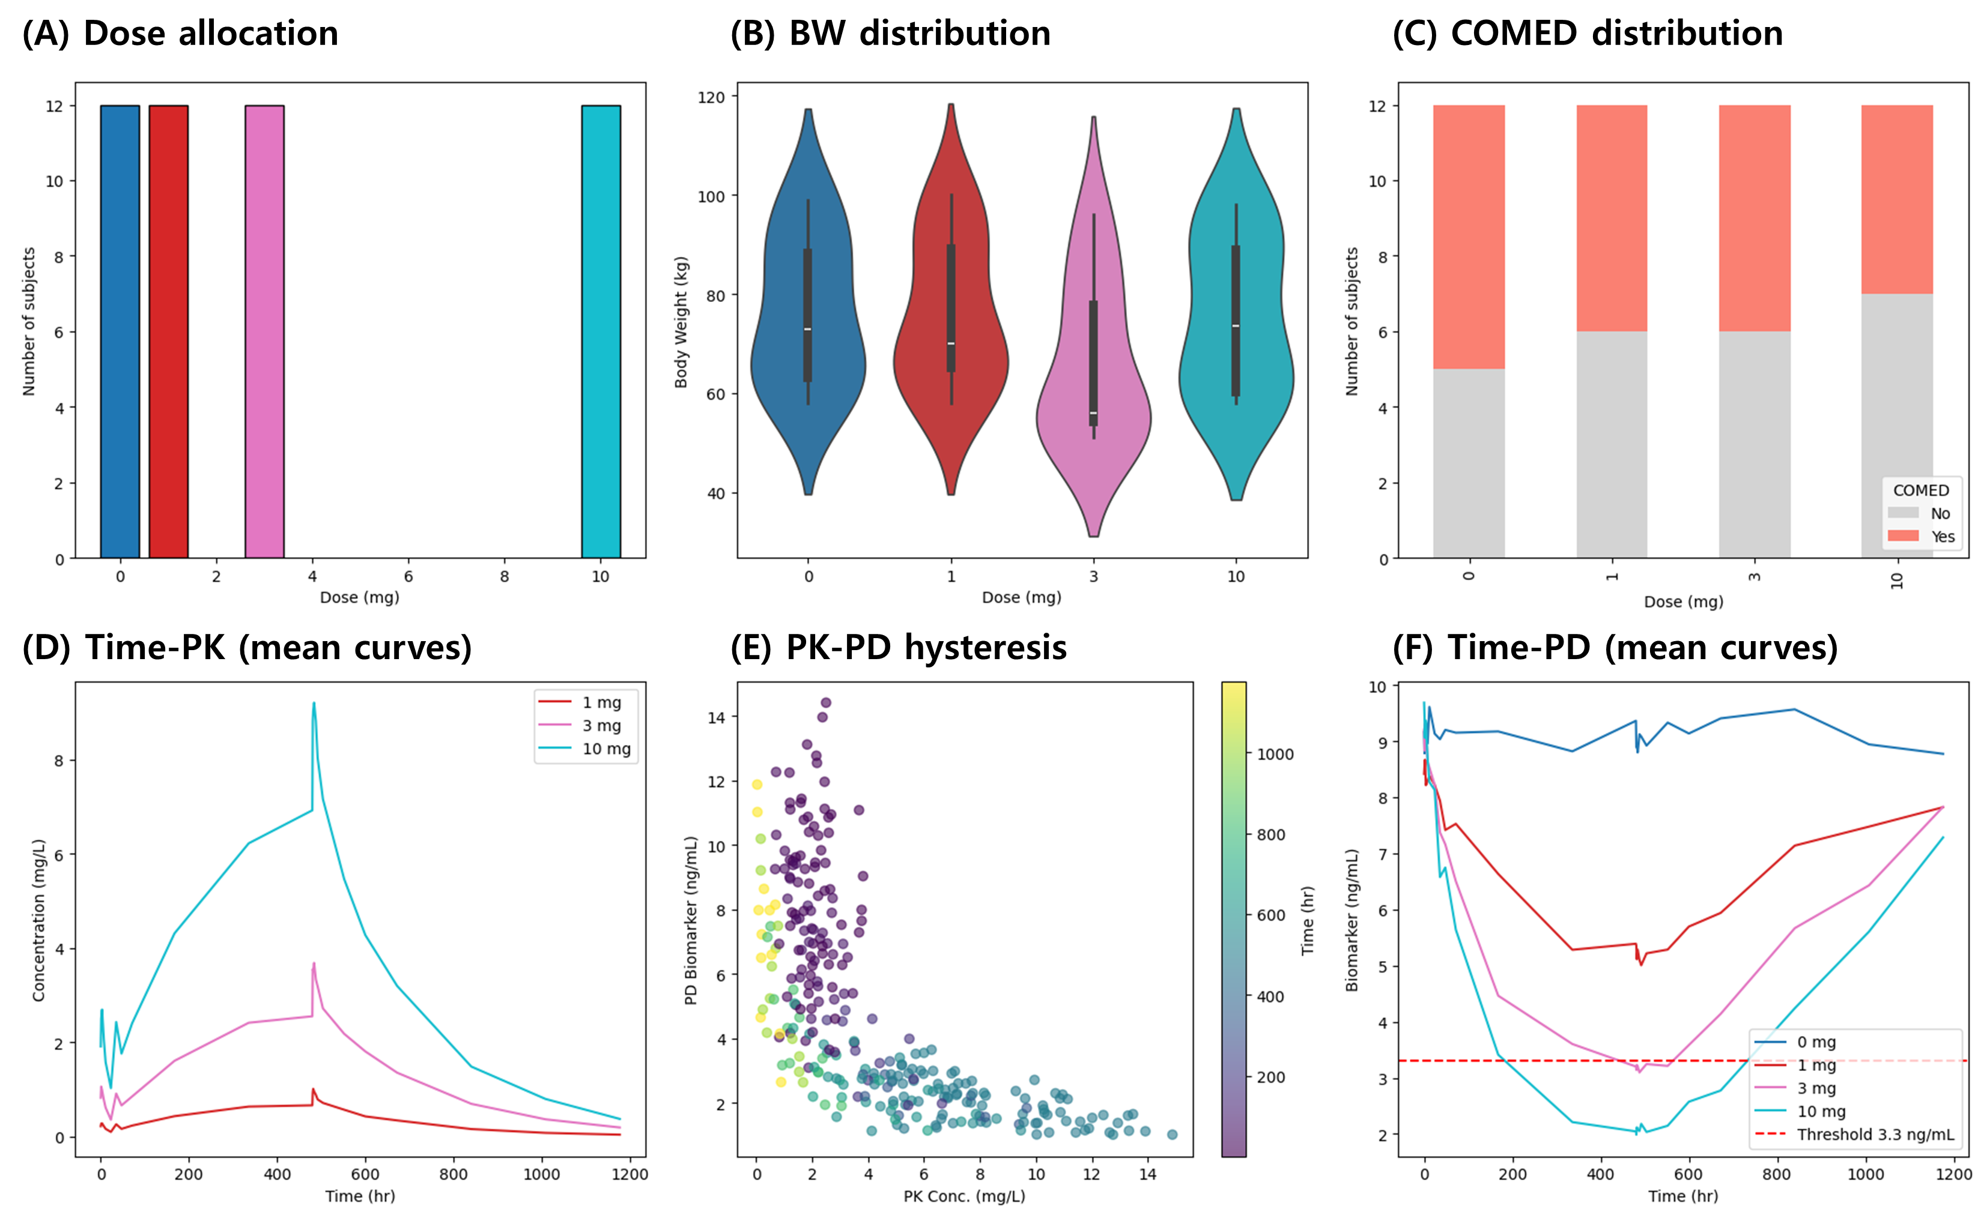
1. Dataset & Task
Task: 1) PK/PD modelling, 2) Dose optimization
Patient Data
Figure 1: Dataset.
Notes:
이 챌린지에서 저희는 PK/PD modelling을 하는 것과 Dose optimization 하는 것을 수행했습니다.
우선 저희는 환자들의 데이터 셋과 PK, PD를 먼저 분석하였습니다. 이 PK와 PD를 예측을 위하여 여러가지 구조들을 시도했었습니다.
In this challenge, our team focused on PK/PD modeling and dose optimization. First, we analyzed the patient dataset along with the pharmacokinetic (PK) and pharmacodynamic (PD) properties. To predict this PK and PD, we experimented with several different model architectures.

Slide 51
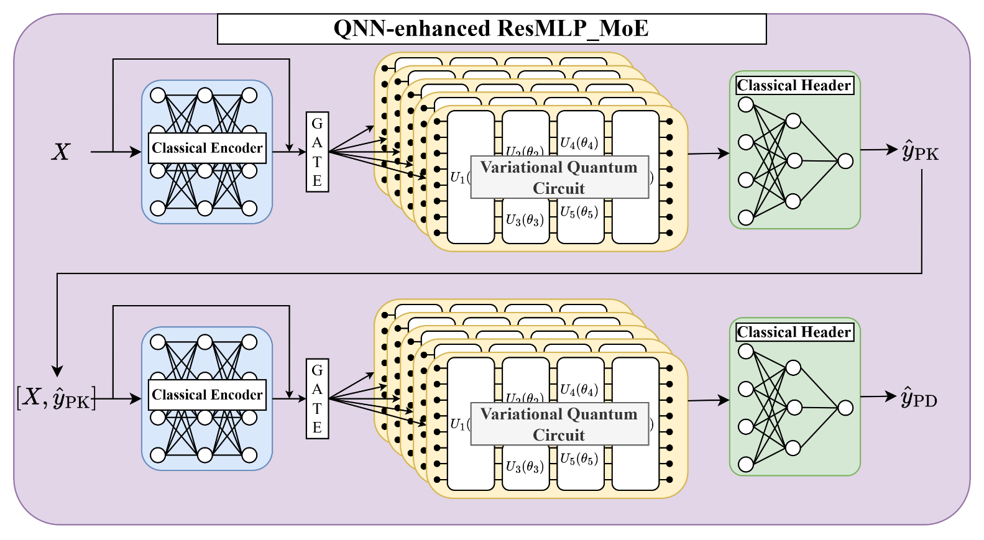
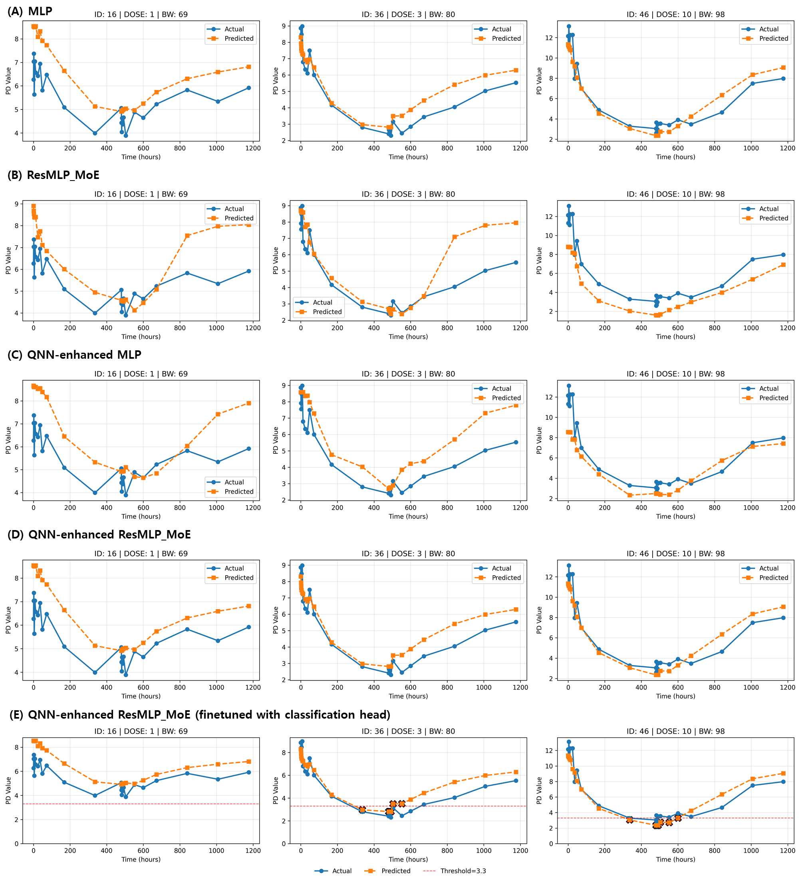
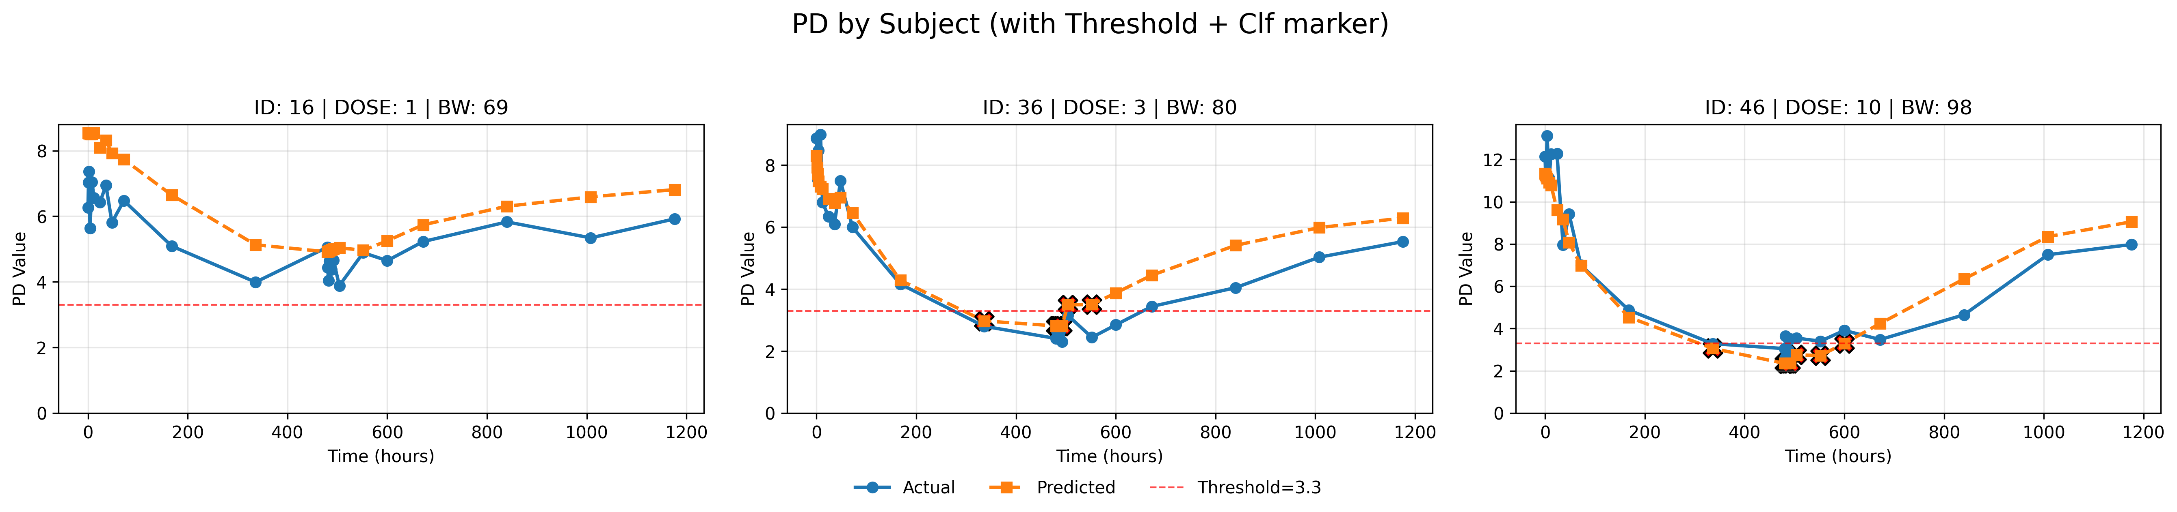


2. Quantum-enhanced ML Framework for Dose Optimization
QNN-enhanced ResMLP_MoE Framework
Input Data
PD value
Classical ML
Bio information
Patient ID
Weight..
Drug Information
Dose
Start Date
Time
PD value
Time (hours)
Quantum ML
Time (hours)
Clinically relevant threshold
Dose Optimization
Team PNU
Dose Optimization (Grid Search / MCTS)
Time-series simulation
(Prediction)
Prof. Giltae Song
Prof. Won-Joo Hwang
Prof. In-Soo Yoon
AI, Biomedical Data
Quantum Computing, AI
PK/PD, Biopharmaceutics
Choose candidate dose
Scoring
(Suppression)
Develops deep learning models for PK/PD prediction
Applies quantum algorithms to PK/PD modeling
Provides domain expertise in PK/PD and clinical pharmacology
Evaluate
& Update
Team Members:
Sanghun Sel, Juseong Kim, Mingyeol Kim
Team Members:
Seon-Geun Jeong, Le Tung Giang,
Nguyen Doan Hieu, Mai Dinh Cong
Specialized in clinical validation and dose optimization strategies
Notes:
In this challenge, we proposed a Quantum Neural Network–enhanced ResMLP_MoE framework for PK/PD prediction and dose optimization. Professor Giltae Song is an expert in bioinformatics and AI, Professor In-Soo Yoon is an expert in biopharmaceutics, and Professor Won-Joo Hwang is an expert in quantum AI. The specific tasks assigned to each expert in our framework are as follows. The input data first pass through a residual-structured classical encoder, and then multiple Quantum Neural Networks are connected in parallel in a Mixture-of-Experts configuration. The final classical header produces either PK or PD outputs, and by adopting a cascade structure, our model can jointly predict PK and PD. For dose optimization, we first generate several candidate dose levels. These candidates are then fed into our model to predict PD values, and we evaluate whether the predicted PD value is below the clinically relevant threshold of 3.3 ng/mL. Through this process, our framework identifies the optimal dose level for each patient.

Slide 52
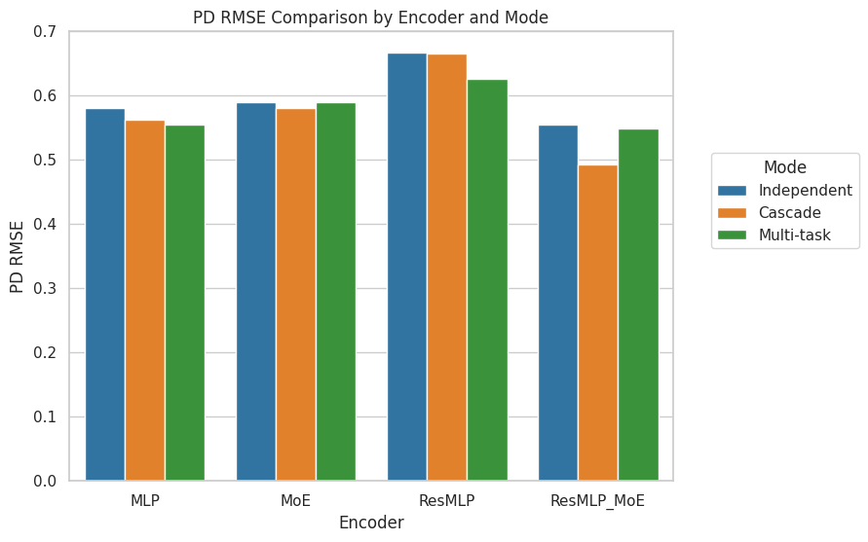
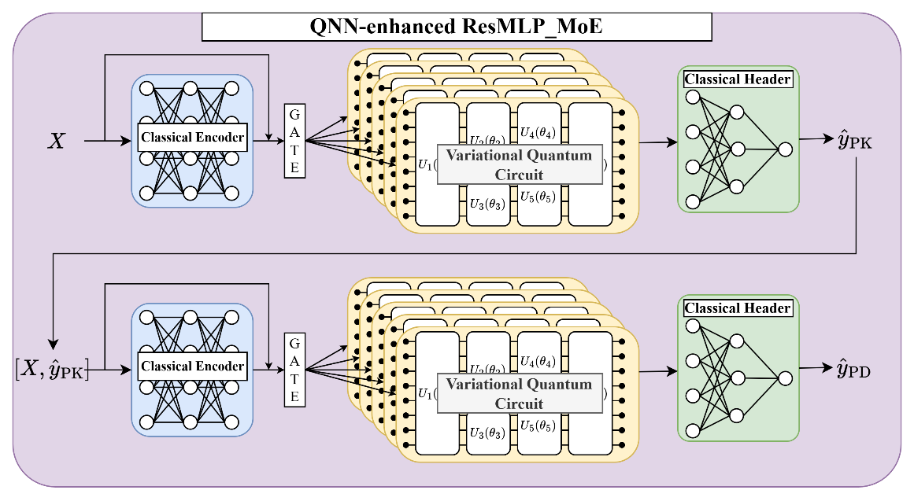
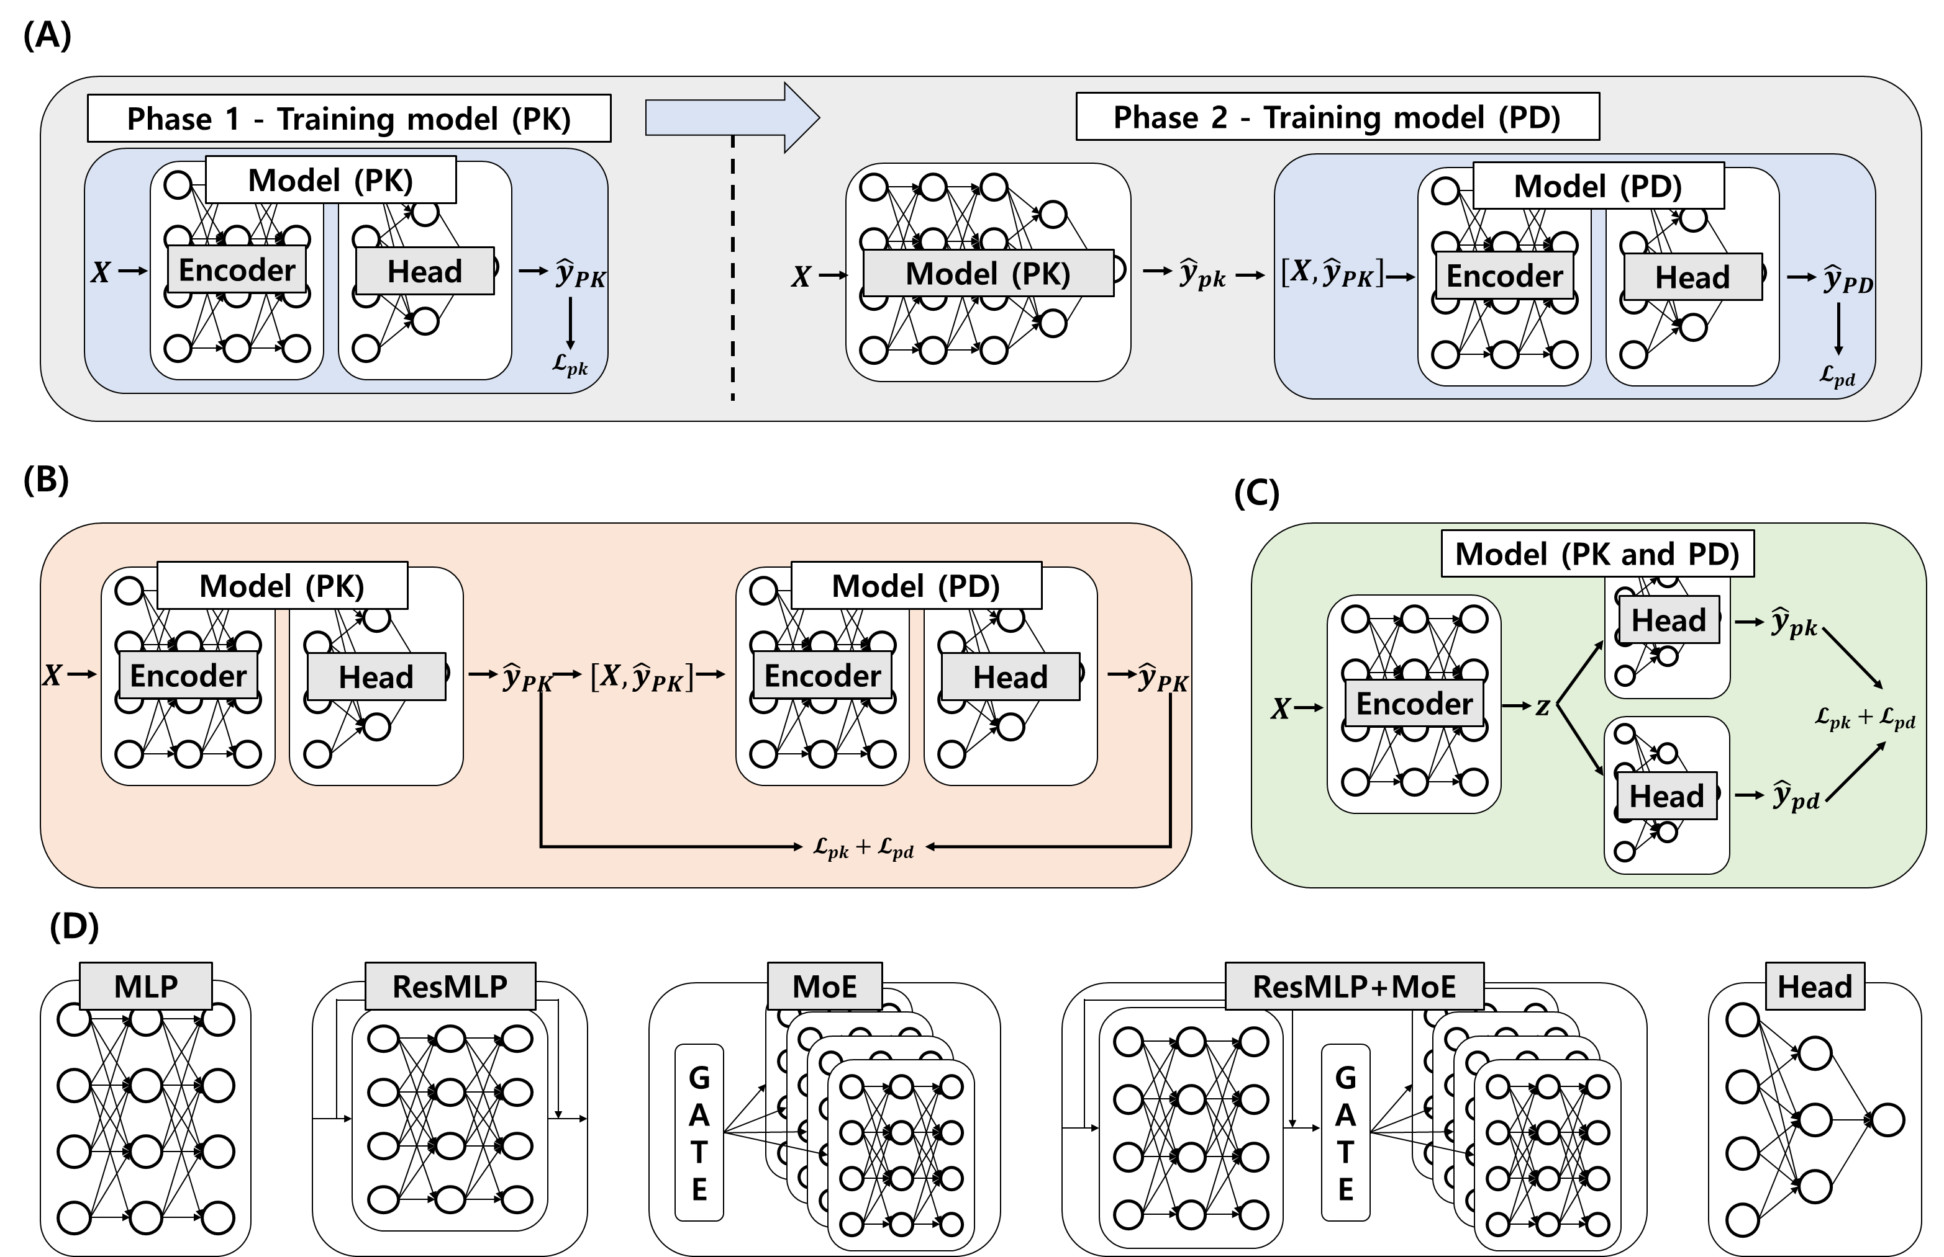
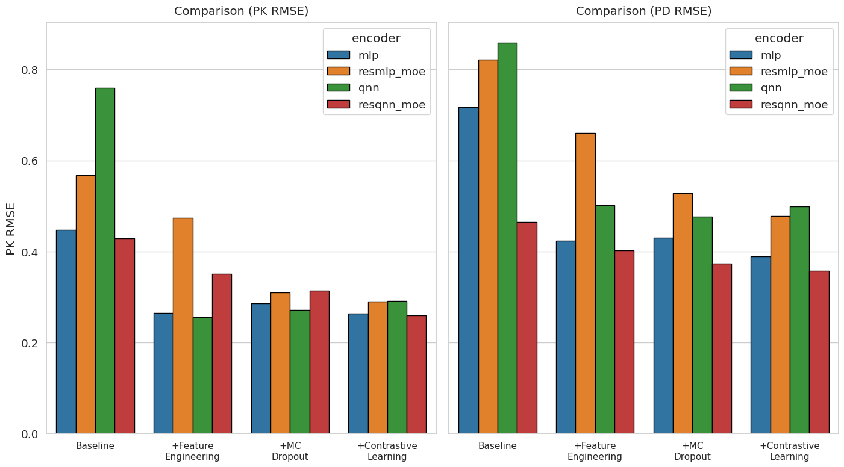
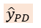
3. Model Search
Cascade + ResMLP+MoE achieves the best performance in terms of PK/PD RMSE.
Independent
Cascade
Multi-task
PD RMSE
Figure 3: QNN-enhanced ResMLP_MoE.
Independent modeling
MLP
MoE
ResMLP
ResMLP_MoE
Best
PK RMSE
PD RMSE
MLP
ResMLP_MoE
QNN
ResQNN_MoE
MLP
ResMLP_MoE
QNN
ResQNN_MoE
Cascade mode
Multi-task mode
RMSE
$${\hat{y}}_{PD}$$
Encoder Backbones
Baseline
+Feature Engineering
+MC
Dropout
+Constrative
Learning
Baseline
+Feature Engineering
+MC
Dropout
+Constrative
Learning
Best
Figure 5: Empirical evaluation results.
Best
Figure 4: Overview of modeling frameworks.
Notes:
여기서는 저희가 어떻게 이 모델을 구현하게 되었는지 보여드리겠습니다.
양자 머신러닝 모델을 개발하기 위해서 다양한 모델링을 시도했습니다.
Independent modeling은 PK와 PD를 따로 학습하는 것이고
Cascade mode는 예측된 PK로 PD를 연이어 예측하는 것입니다.
Multi-task mode의 경우 PK와 PD를 예측하는 두개의 헤드가 병렬로 존재합니다.
Encoder backnone의 경우 여러가지 backbone들을 후보로 두어 실험했습니다.
오른쪽 실험 결과를 보시면 Cascade에서 ResMLP_MoE가 best였으며 추가로 feature engineering, montecarlo dropout, constrative learning등 여러가지 기법들을 실험 했을 때
Constrative learning이 best였으며 이로 인해 저희는 최종적으로 QNN-enhanced ResMLP_MoE 모델을 채택하였습니다.
I will show how we implemented our model.
To develop the quantum machine-learning model, we explored multiple modeling strategies. Independent modeling trains PK and PD separately. Cascade model predicts PK first which is input of PD predictor. Multi-task model uses two parallel heads to predict PK and PD jointly. For the encoder backbone, each encoder is the candidate backbones. As shown in the results on the right, ResMLP_MoE achieved the best performance in the cascade setting. We also evaluated feature engineering, Monte Carlo dropout, and contrastive learning; among these, contrastive learning performed the best. Based on these findings, we finally adopted the QNN-enhanced ResMLP_MoE as our model.

Slide 53
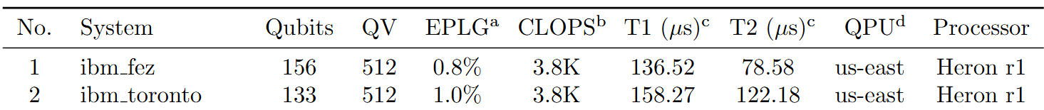
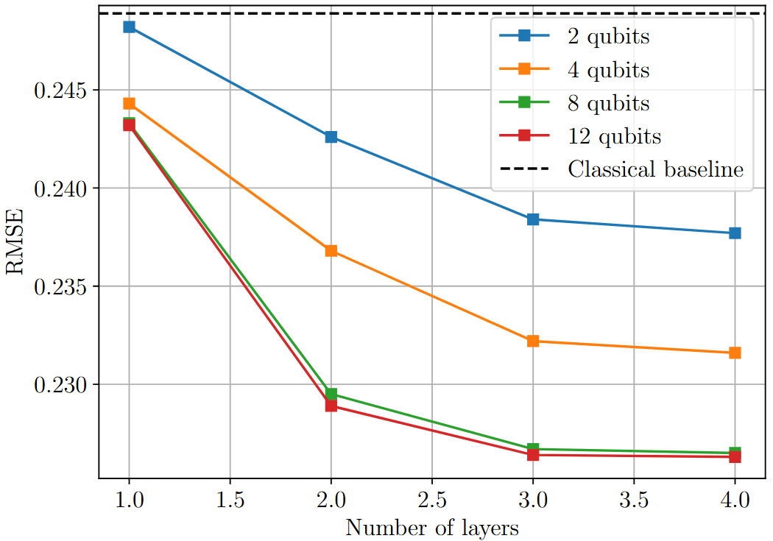
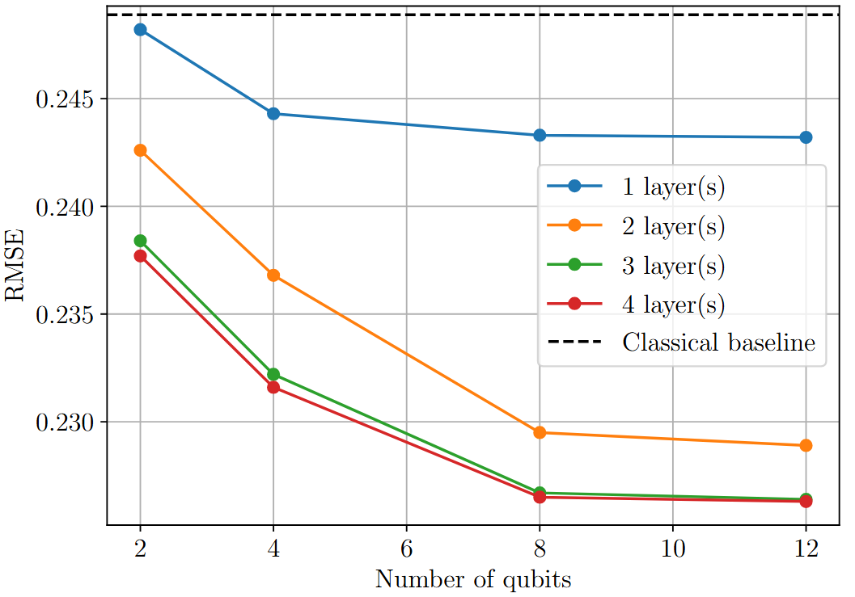

3. Quantum Model (Qubits, Layers, Advantage)
Technical Feasibility: Based on IBM quantum systems, the quantum volume reflects the maximum circuit size with widith $≈$ depth. State-of-the-arts $QV=512⇒T≤9$. That is, (9 qubits and 9 depth)
Table 1: The up-to-date IBM Quantum’s quantum computers
Figure 6: Results of QNN-enhanced ResMLP_MoE
[1] Jeong, Seon-Geun, Kyeong-Hwan Moon, and Won-Joo Hwang. "Hybrid quantum neural networks for efficient protein-ligand binding affinity prediction." EPJ Quantum Technology 12.1 (2025): 1-36.
Notes:
To consider the technical feasibility on real quantum computer, we assume that this model is implemented on IBM quantum computer.
We calculated the maximum circuit size and depth of quantum model based on IBM quantum computer spec.
So, we defined the maximum circuit size is 9 qubits and 9 depth.
Based on this setting, we conducted the simulations, then when we increase the number of qubits, the performance is increased.
Even if we design the 12 qubits system, its performance is similar with 8 qubits. This result is similar in number of layers case.
So, our model consists of 8 qubits and 4 layers.

Slide 54














4. Conclusion
Quantum advantages [1]:
1) Model complexity reduction
2) approximation performance (Neural Network $F\left(x\right)$, Quantum Neural Network $Q(x)$, continuous function $f(x)$) $\left|f\left(x\right)−F\left(x\right)\right|dx<ε$ , $\left|f\left(x\right)−Q\left(x\right)\right|dx<δ$. ($ε>δ$) in the same number of parameters.
3) model convergence speed (Training time)
4) inference time (Faster than NN)
5) higher expressivity (Small dataset).
Mathematical
algorithm
CPU/GPU
Processing
Life Science
Task
Mathematical
Algorithm
Quantum
Processing
Life Science
Task
Time
Performance
Time
Performance
$$N$$
$$2^{N}$$
Classical representation Space
Quantum Hilbert representation Space
[1] Jeong, Seon-Geun, Kyeong-Hwan Moon, and Won-Joo Hwang. "Hybrid quantum neural networks for efficient protein-ligand binding affinity prediction." EPJ Quantum Technology 12.1 (2025): 1-36.
Notes:
I will finish this presentation by concluding the quantum advantage.
We expect there is the quantum advantage in terms of model complexity reduction, approximation performance, model convergence speed, inference time, and higher expressivity.
If we design the neural network and quantum neural network in the same number of parameters. We can reduce the depth. And in terms of approximiation performance, QNN is known as better than NN.
In the training, QNN converges faster than NN..
In the inference time, QNN is faster than NN.
For the representation space, the qubit can represent the input data in larger space.

Slide 55
Thank you!
Notes:
Thank you.

Slide 56
Quantum Innovation Challenge 2025
quantum-challenge.eu
Team QuantumDose
Thando Khumalo & Byoungwoo Kang
UCLA (University of Los Angeles)
USA

Slide 57
Quantum Dose
PK/PD Modeling Utilizing Transformers, QIHMC, Quantum Kernels
Byoungwoo Kang, Thando Khumalo

Slide 58



Motivation
Why add “Quantumness” to the PK/PD problem?
?
Choice of PDE
Poor Exploration of Parameter Space
Small Dataset

Slide 59


Quantum Dose Method
Stage 1
Transformer Encoder for PK/PD Model Identification
Stage 2
Quantum Inspired Hamiltonian Monte Carlo
Stage 3
Quantum Kernel Method for Support Vector Regression
T E
PK/PD 1
V
k_{a}
CL
time

Slide 60
Advantages
Stage 1: Narrowing down the PK/PD model for improved efficiency in Stage 2/3
Stage 2: A stochastic exploration of parameter space: Tunable weight parameter to overcome large potentials
Stage 3: Quantum correlations that can’t be captured by classical relationships, which potentially provide fundamental understanding from small datasets.

Slide 61





Acknowledgements
Prineha Narang
William Munizzi
Aman Mehta
Jack Diab
Scott Nie
Quantum Innovation Challenge Organizing Committee

Slide 62








Quantum Innovation Challenge 2025
The Jury
Cathal
Mahon
Clément
Javerzac-Galy
Jeroen
Bakker
Ulrik Nicolai
de Lichtenberg
Michael
D’Andrea
Tobias
Denzler
Maxime
Oliva
Niels Rode
Kristensen

